Slide 1
You are the Key to HPV Cancer Prevention
Understanding the Burden of HPV Disease, the Importance of the HPV Vaccine Recommendation, and Communicating about HPV Vaccination
Speaker Name
Speaker Title
Speaker Affiliation
{Updated August 5, 2014; Replace with date of Presentation}

Slide 2
Disclosure
Please add any financial disclosures or conflicts of interest to this slide
Notes:
Note: Please have speaker add any financial disclosures or conflicts of interest to this slide.

Slide 3
Summary
Stagnant HPV vaccination rates are leaving another cohort of boys and girls vulnerable to devastating HPV cancers. Vaccination could prevent most of these cancers.
Provided in this presentation is up-to-date information on HPV infection, HPV-related disease, and HPV cancers.
HPV vaccine information and recommendations, as well as HPV vaccine safety and impact, are reviewed.
The presentation also provides evidence-based suggestions for successful HPV vaccine communication with patients and their parents, as well as the current HPV vaccine communication resources available from CDC.

Slide 4
Objectives
Define the importance of HPV vaccination for cancer prevention and the rationale for vaccinating at ages 11 or 12.
List the indications for HPV vaccine for girls and for boys.
Provide useful and compelling information about HPV vaccine to parents to aid in making the decision to vaccinate.
Locate resources relevant to current immunization practice.

Slide 5
HPV Infection & Disease
Understanding the Burden
Notes:
The first section will focus on HPV infection and disease prevalence.

Slide 6
HPV Types Differ in their
Disease Associations
~40 Types
Mucosal
sites of infection
Cutaneous
sites of infection
~ 80 Types
High risk (oncogenic)
HPV 16, 18
Low risk (non-oncogenic)
HPV 6, 11
Cervical Cancer Anogenital Cancers Oropharyngeal Cancer Cancer Precursors
Low Grade Cervical Disease
Genital Warts
Laryngeal Papillomas
Low Grade Cervical Disease
“Common”
Hand and Foot
Warts
Notes:
HPV types differ in their tendency to infect cutaneous and mucosal or genital epithelium. There are approximately 40 types frequently found in the genital tract. These are grouped as high risk or oncogenic types, including HPV 16,HPV 18. Persistent infection with these types can result in cancers including cervical, other anogenital and orpharyngeal cancer, and low grade cervical disease.
Low risk or non oncogenic types, such as types HPV 6, HPV 11 can cause anogential warts as well as laryngeal papillomas and low grade cervical disease.
The cutaneous HPV types cause the common hand and foot warts.

Slide 7
HPV Infection
Most females and males will be infected with at least one type of HPV at some point in their lives
  Estimated 79 million Americans currently infected
  14 million new infections/year in the US
  HPV infection is most common in people in their teens and early 20s
Most people will never know that they have been infected
Jemal A et al. J Natl Cancer Inst 2013;105:175-201
Notes:
HPV is the most common sexually transmitted infection
Most people never know that they have been infected unless a woman has an abnormal pap test with a positive HPV test
Most HPV infections happen during the teen and college-aged years

Slide 8
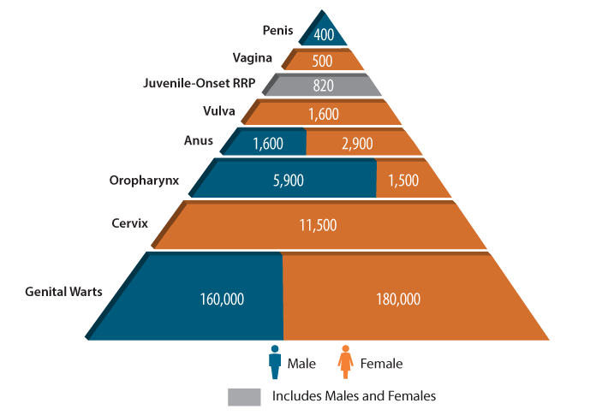
Numbers of Cancers and Genital Warts Attributed to HPV Infections, U.S.
CDC. Human papillomavirus (HPV)-associated cancers. Atlanta, GA: US Department of Health and Human Services, CDC; 2013. Available at http://www.cdc.gov/cancer/hpv/statistics/cases.htm
Notes:
Each year in the United States, an estimated 26,000 new cancers are attributable to HPV, about 17,000 in women and 9,000 in men.

Slide 9
Cancers Attributed to HPV, U.S.
Cancer site | Average number of cancers per year in sites where HPV is often found |  |  | Percentage of cancers per year probably caused by HPV | Average number of cancers per year probably caused by HPV†
 | Male | Female | Both Sexes |  | Male | Female | Both Sexes
Anus | 1,549 | 2,821 | 4,370 | 91% | 1,400 | 2,600 | 4,000
Cervix | 0 | 11,422 | 11,422 | 91% | 0 | 10,400 | 10,400
Oropharynx | 9,974 | 2,443 | 12,417 | 72% | 7,200 | 1,800 | 9,000
Penis | 1,048 | 0 | 1,048 | 63% | 700 | 0 | 700
Vagina | 0 | 735 | 735 | 75% | 0 | 600 | 600
Vulva | 0 | 3,168 | 3,168 | 69% | 0 | 2,200 | 2,200
TOTAL | 12,571 | 20,589 | 33,160 |  | 9,300 | 17,600 | 26,900
CDC, United States Cancer Statistics (USCS), 2006-2010
Notes:
A large majority of cancers caused by HPV are brought about by one of two types: HPV16 or HPV18. Together, these types cause about 22,000 cases of cancer in the United States each year.
An HPV-associated cancer is a cancer that is diagnosed in a part of the body where HPV is often found (first column of the table). These parts of the body include the cervix, anus, penis, vagina, vulva, and oropharynx (back of the throat, including the base of the tongue and tonsils).
An HPV-attributable cancer is a cancer that is probably caused by HPV (second and third columns of the table). HPV causes nearly all cervical cancers and many cancers of the anus, penis, vagina, vulva, and oropharynx. CDC studies used population-based data from cancer tissue to estimate the percentage of these cancers that are probably caused by HPV.

Slide 10
Average Number of New Cancers Probably Caused by HPV, by Sex, United States 2006-2010
Penis
n=700
8%
Vagina
n=600
3%
Vulva
n=2,200
13%
Anus
n=2,600
15%
Anus
n=1,400
15%
Oropharynx
n=1,800
10%
Cervix
n=10,400
59%
Oropharynx
n=7,200
77%
Women (n = 17,600)
Men (n = 9,300)
CDC, United States Cancer Statistics (USCS), 2006-2010

Slide 11
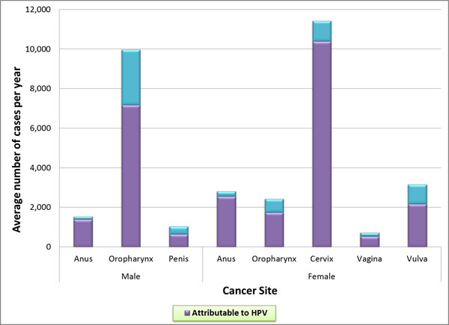
How Many Cancers Are Linked with HPV Each Year?

Slide 12
Cervical Cancer
Cervical cancer is the most common HPV-associated cancer among women
  500,000+ new cases and 275,000 attributable deaths world-wide in 2008
  11,000+ new cases and 4,000 attributable deaths in 2011 in the U.S.
  37% cervical cancers occur in women who are between the ages of 20 and 44
  13% (or nearly 1 in 8) between 20 and 34
  24% ( or nearly 1 in 4) between 35 and 44
CDC. HPV–associated cancers—US, 2004–2008. MMWR 2012;61(15):258–261.
Cervical Cancer Counts by Age. US Cancer Statistics data from 2010, CDC.gov.
Notes:
Cervical cancer was once the leading cause of cancer death for women in the United States. Now it is the most preventable of all of the female cancers. The Pap test has helped decrease the number of women in the U.S. with cervical cancer by about 75% in the past 50 years. However even with an excellent cervical cancer screening program in the U.S., there are still over 11,000 cases of cervical cancer each year in this country.
Many people think of gynecological cancers as just affecting older women, but cervical cancer affects 1 in 3 women who are of reproductive age

Slide 13
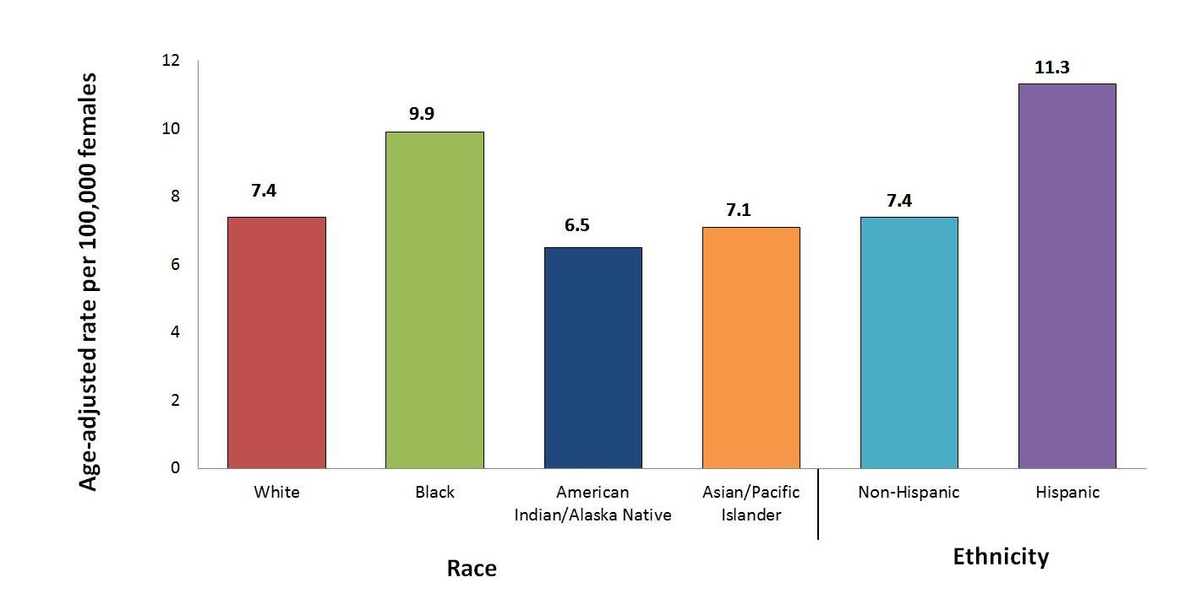
HPV-Associated Cervical Cancer Rates by Race and Ethnicity, United States, 2004–2008
Watson et al. Human papillomavirus-associated cancers—United States, 2004-2008. MMWR 2012;61:258-261.
Notes:
Cervical cancer affects women of color and their communities more than their white counterparts. Women of color are often diagnosed with cervical cancer at a later stage than white women. Black women are more likely to die from cervical cancer than women of other races or ethnicities, possibly because of decreased access to Pap testing or follow-up treatment.
Hispanic women have the highest rates of cervical cancer in the United States. For example, for every 100,000 women living in the U.S., about 11 Hispanic women are diagnosed with cervical cancer, compared to only seven non-Hispanic women.

Slide 14
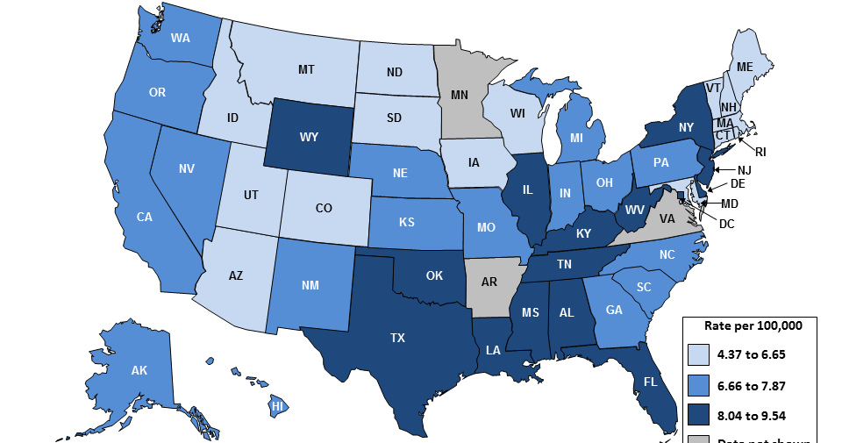
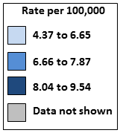
HPV-Associated Cervical Cancer Incidence Rates by State, United States, 2004–2008
HPV-Associated Cervical Cancer Incidence Rates by State, United States, 2006-2010
www.cdc.gov/cancer/npcr
Notes:
This map displays HPV-associated cervical cancer incidence rates by state.

Slide 15
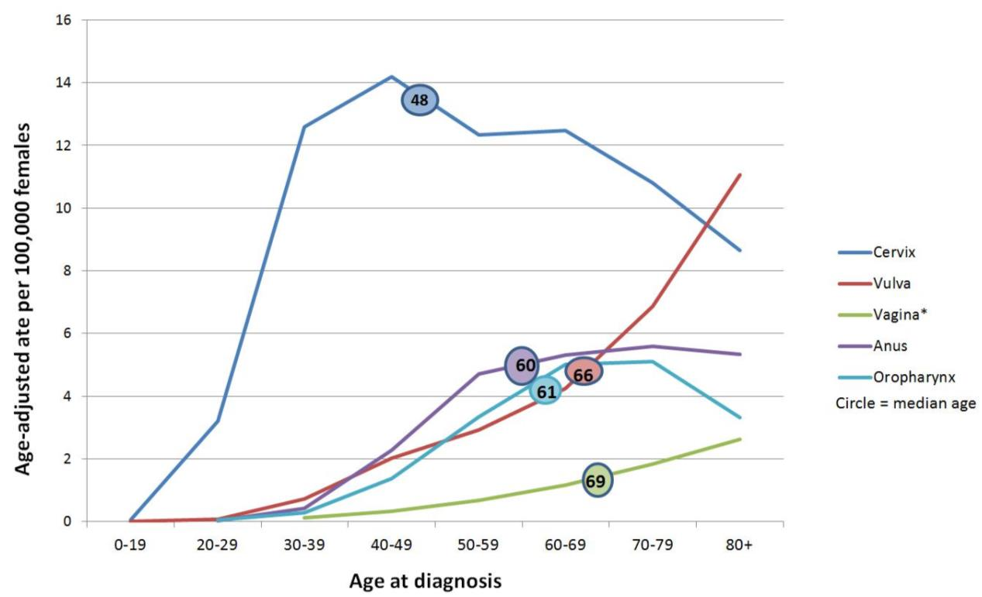
Rates of HPV-Associated Cancer and Median Age at Diagnosis Among Females in the United States, 2004–2008
Rates of HPV-Associated Cancer and Median Age at Diagnosis Among Females, United States, 2004–2008
*The vaginal cancer statistics for women between the ages of 20 and 39 is not shown because there were fewer than 16 cases.
Watson et al. Human papillomavirus-associated cancers—United States, 2004-2008. MMWR 2012;61:258-261.

Slide 16
Annual Report to the Nation on the Status of Cancer: HPV-Associated Cancers
From 2000 to 2009, oral cancer rates increased
  4.9% for Native American men
  3.9% for white men
  1.7% for white women
  1% for Asian men
Anal cancer rates doubled from 1975 to 2009
Vulvar cancer rates rose for white and African-American women
Penile cancer rates increased among Asian men
Jemal A et al. J Natl Cancer Inst 2013;105:175-201
Notes:
All types of HPV cancers are on the rise, some disproportionately affecting different racial/ethnic minorities. Unfortunately, there is no routine screening recommended for these other HPV-associated cancers, so vaccination is the best and only prevention strategy.

Slide 17
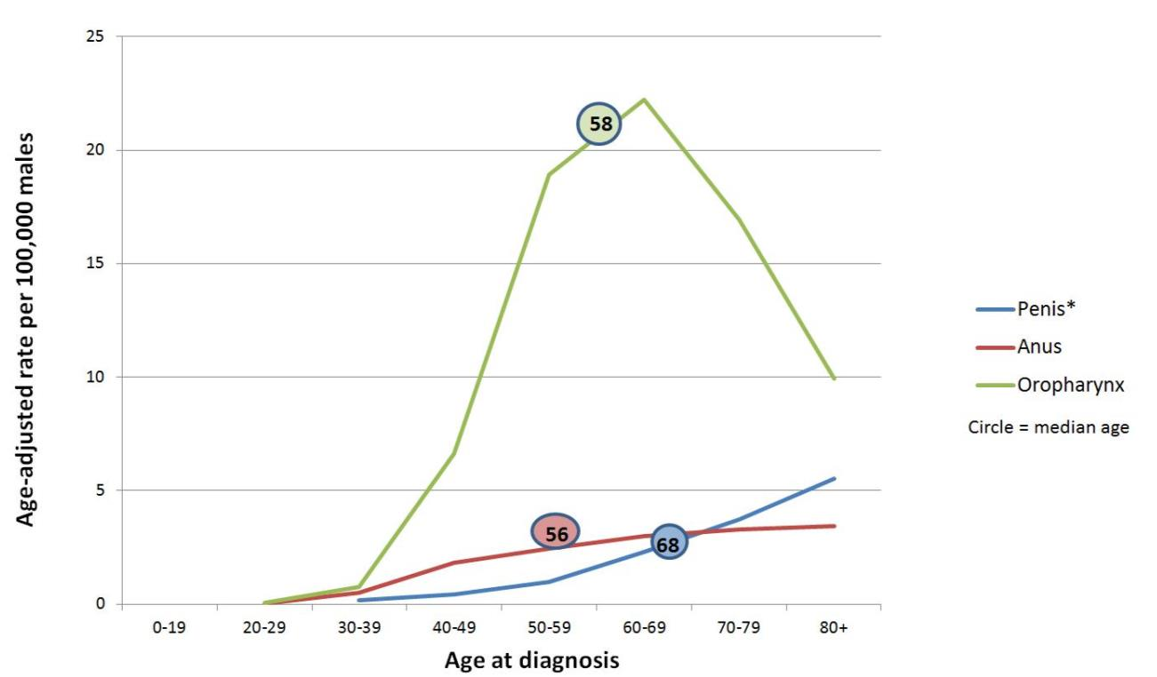
Rates of HPV-Associated Cancer and Median Age at Diagnosis Among Males in the United States, 2004–2008
Rates of HPV-Associated Cancer and Median Age at Diagnosis Among Males, United States, 2004–2008
*The penile cancer statistics for men between the ages of 20 and 39 is not shown because there were fewer than 16 cases.
Watson et al. Human papillomavirus-associated cancers—United States, 2004-2008. MMWR 2012;61:258-261.

Slide 18
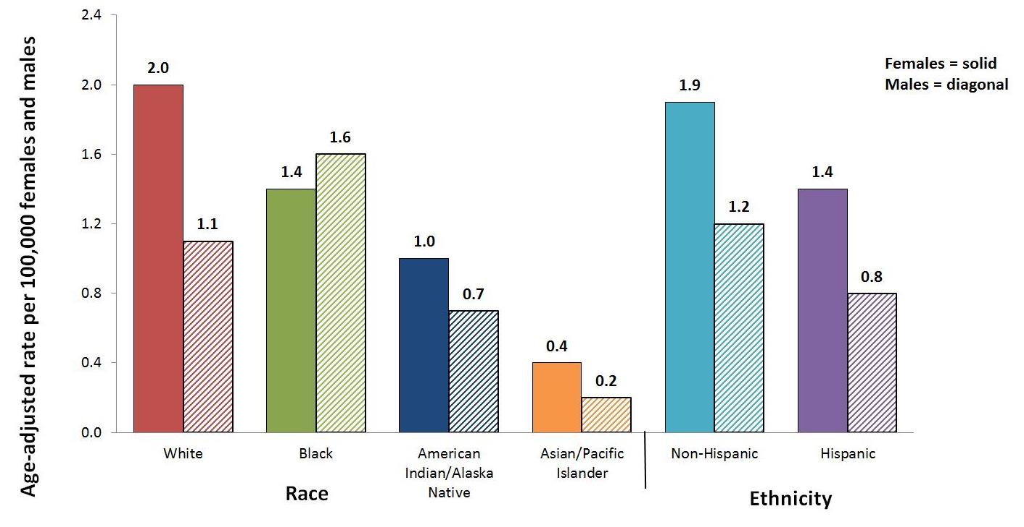
HPV-Associated Anal Cancer Rates by Race and Ethnicity, United States, 2004–2008
HPV-Associated Anal Cancer Rates by
Race and Ethnicity, United States, 2004–2008
Watson et al. Human papillomavirus-associated cancers—United States, 2004-2008. MMWR 2012;61:258-261.

Slide 19
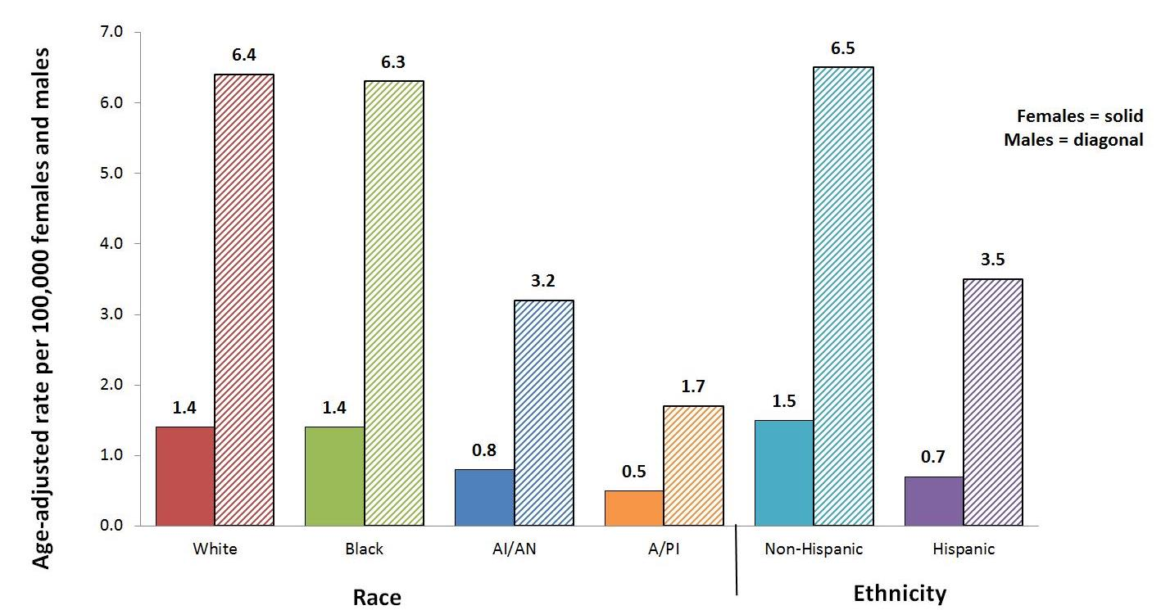
HPV-Associated Oropharyngeal Cancer Rates by Race and Ethnicity, United States, 2004–2008
HPV-Associated Oropharyngeal Cancer Rates by
Race and Ethnicity, United States, 2004–2008
Watson et al. Human papillomavirus-associated cancers—United States, 2004-2008. MMWR 2012;61:258-261.

Slide 20
Without vaccination, annual burden of genital HPV-related disease in U.S. females:
4,000 cervical cancer deaths
10,846 new cases of cervical cancer
330,000 new cases of HSIL: CIN2/3
(high grade cervical dysplasia)
1 million new cases of genital warts
1.4 million new cases of LSIL: CIN1
(low grade cervical dysplasia)
3 million cases and $7 billion
American Cancer Society. 2008; Schiffman Arch Pathol Lab Med. 2003; Koshiol
Sex Transm Dis. 2004; Insinga, Pharmacoeconomics, 2005
Notes:
Key Point
Human papillomavirus (HPV) infection is very common, but, in the majority of cases, has no clinical manifestation. Of all HPV-related conditions, cervical cancer is the most serious. However, most HPV-related morbidity is associated with cervical dysplasia or genital warts. Cervical dysplasia is caused by both oncogenic and nononcogenic types, and genital warts by nononcogenic types.
Background
The estimated annual incidence of low- and high-grade dysplasia in the United States is 1.4 million, and 330,000 cases, respectively.¹ There are an estimated 1 million new cases of genital warts occurring every year in the United States.² The American Cancer Society estimates that in 2006, 9,710 women in the United States will develop cervical cancer.³
More than 100 HPV types have been detected,⁴ with >80 types sequenced and classified.⁵ Approximately 30 to 40 of these types of HPV infect the genital tract.^{4,5} Of these, Types 16 and 18 cause about 70% of cervical cancer,⁶ at least 50% of all high-grade cervical dysplasia,⁷ and, along with HPV Types 6 and 11, approximately 35% of all low-grade cervical dysplasias.⁸ A study has shown that HPV 6 and 11 also cause 90% of anogenital warts.⁹
References
1. Schiffman M, Solomon D. Findings to date from the ASCUS-LSIL Triage Study (ALTS). Arch Pathol Lab Med. 2003;127:946–949.
2. Fleischer AB, Parrish CA, Glenn R, et al. Condylomata acuminata (genital warts): Patient demographics and treating physicians. Sex Transm Dis. 2001;28:643–647.
3. American Cancer Society. Cancer Facts and Figures 2006. Atlanta, Ga: American Cancer Society; 2006:4.
4.Schiffman M, Castle PE. Human papillomavirus: epidemiology and public health. Arch Pathol Lab Med. 2003;127:930–934.
5. Wiley DJ, Douglas J, Beutner K, et al. External genital warts: diagnosis, treatment, and prevention. Clin Infect Dis. 2002;35(suppl 2):S210–S224.
6. Muñoz N, Bosch FX, de Sanjosé S et al. Epidemiologic classification of human papillomavirus types associated with cervical cancer. N Engl J Med. 2003;348:518–527.
7. Clifford GM, Smith JS, Aguado T, et al. Comparison of HPV type distribution in high-grade cervical lesions and cervical cancer: a meta-analysis. Br J Cancer. 2003;89:101–105.
8. Clifford GM, Rana RK, Franceschi S, et al. Human papillomavirus genotype distribution in low-grade cervical lesions: comparison by geographic region and with cervical cancer. Cancer Epidemiol Biomarkers Prev. 2005;14:1157–1164.
9. Gissmann L, Wolnik L, Ikenberg H, Koldovsky U, Schnurch HG, zur Hausen H. Human papillomavirus types 6 and 11 DNA sequences in genital and laryngeal papillomas and in some cervical cancers. Proc Natl Acad Sci USA. 1983;80:560–563.
Assessing the Annual Economic Burden of Preventing and Treating Anogenital Human Papillomavirus-Related Disease in the US: Analytic Framework and Review of the Literature
Authors: Insinga, Ralph P.¹; Dasbach, Erik J.¹; Elbasha, Elamin H.¹
Source: PharmacoEconomics, Volume 23, Number 11, 2005 , pp. 1107-1122(16)

Slide 21
HPV Vaccine
Evidence-Based HPV Prevention
Notes:
This next section will focus on HPV vaccine.

Slide 22
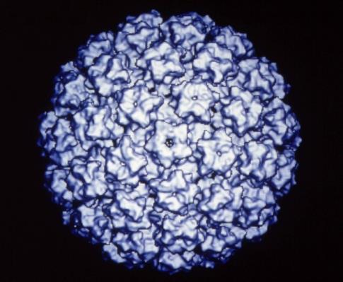
HPV Prophylactic Vaccines
Recombinant L1 capsid proteins that form
“virus-like” particles (VLP)
Non-infectious and
non-oncogenic
Produce higher levels of neutralizing antibody than natural infection
HPV Virus-Like Particle
Notes:
HPV vaccines are made from virus-like particles that cannot cause infection with HPV or cause cancer. HPV vaccines produce a better immune response than an HPV infection.

Slide 23
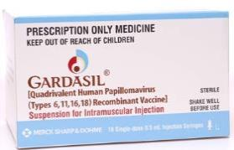
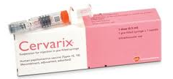
HPV Vaccine
Quadrivalent/HPV4 (Gardasil) | Name | Bivalent/HPV2 (Cervarix)
Merck | Manufacturer | GlaxoSmithKline
6, 11, 16, 18 | Types | 16, 18
Females: Anal, cervical, vaginal and vulvar precancer and cancer; Genital warts Males: Anal precancer and cancer; Genital warts | Indications | Females: Cervical precancer and cancer Males: Not approved for use in males
Hypersensitivity to yeast | Contraindications | Hypersensitivity to latex (latex only contained in pre-filled syringes, not single-dose vials)
3 dose series: 0, 2, 6 months | Schedule (IM) | 3 dose series: 0, 1, 6 months
Notes:
There are two brands of HPV vaccine on the market. This slide was developed at the request of healthcare providers who wanted to see a side-by-side comparison of the two vaccines.
No clinical trial data are currently available to demonstrate efficacy for prevention of oropharyngeal or penile cancers. However, because many of these are attributable to HPV16, the HPV vaccine is likely to offer protection against these cancers as well.

Slide 24
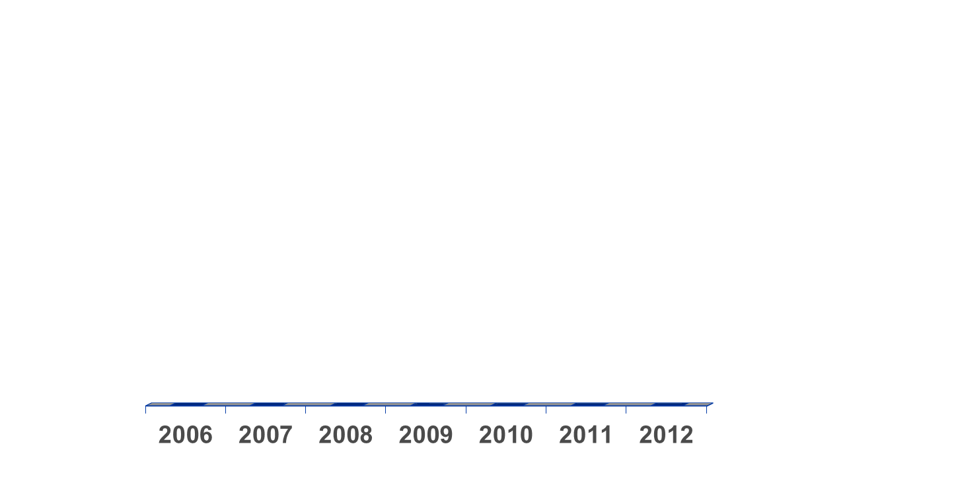
Evolution of recommendations for
HPV vaccination in the United States
Quadrivalent
Routine, females 11 or 12 yrs*
and 13-26 yrs not previously vaccinated
Quadrivalent or Bivalent
Routine, females 11 or 12 yrs*
and 13-26 yrs not previously vaccinated
Quadrivalent
May be given,
males 9-26 yrs*
Quadrivalent
Routine, males 11 or 12 yrs*
and 13-21 yrs not previously vaccinated
May be given, 22-26 yrs**
June
October
Quadrivalent (HPV 6,11,16,18) vaccine; Bivalent (HPV 16,18) vaccine
Can be given starting at 9 years of age;
** For MSM and immunocompromised males, quadrivalent HPV vaccine through 26 years of age
Notes:
This slide shows the evolution of HPV vaccine recommendations in the US.

Slide 25
ACIP Recommendation and
AAP Guidelines for HPV Vaccine
Routine HPV vaccination recommended for both males and females ages 11-12 years
Also ages 13-21 years for males; 13-26 for females
Vaccine can be given starting at age 9 years of age for both males and females; vaccine can be given ages 22-26 years for males
CDC. Quadrivalent Human Papillomavirus Vaccine: Recommendations of ACIP. MMWR 2007;56(RR02):1-24.
Notes:
Females:
Either bivalent HPV vaccine (Cervarix) or quadrivalent HPV vaccine (Gardasil) recommended for girls at age 11 or 12 years for prevention of cervical cancer and precancer
Also for girls 13 through 26 who haven’t started or completed series
Quadrivalent HPV vaccine (Gardasil) also for prevention of vaginal, vulvar, and anal cancers, as well as genital warts.
Males:
Quadrivalent HPV vaccine (Gardasil) recommended for boys at age 11 or 12 years for prevention of anal cancer and genital warts
Also for boys 13 through 21 who haven’t started or completed series
Young men, 22 through 26 years of age, may get the vaccine
Teen boys through age 26 who identify as gay or bisexual and haven’t started or completed series should be vaccinated

Slide 26
HPV Vaccination Schedule
ACIP Recommended schedule is 0, 1-2*, 6 months
  Following the recommended schedule is preferred
Minimum intervals
  4 weeks between doses 1 and 2
  12 weeks between doses 2 and 3
  24 weeks between doses 1 and 3
Administer IM
CDC. Quadrivalent Human Papillomavirus Vaccine: Recommendations of ACIP. MMWR 2007;56(RR02):1-24.
Notes:
ACIP recommended schedule for the 3-dose series is 0, 1 to 2 months and 6 months for either vaccine.
(The FDA-approved schedule for HPV4 is 3 doses at 0, 2, and 6 months. The schedule is slightly different for HPV2- 3 doses at 0 , ONE and 6 months. ACIP reconciled this difference by recommending a schedule of 0, 1 to 2 months, and 6 months for either vaccine. )
The minimum intervals for both vaccines are 4 weeks between the first and second doses, 12 weeks between the second and third doses, and 24 weeks between the first and third doses. However, minimum intervals between doses should NOT be used for routine HPV vaccination. There are almost no situations where a compressed or accelerated schedule is needed.
Remember that the series can be started as early as 9 years of age.

Slide 27
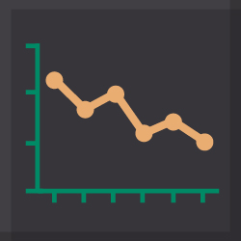
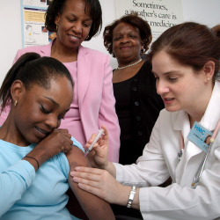

HPV Vaccine is an Anti-Cancer Vaccine
Reduction in prevalence of vaccine-type HPV by 56% in girls age 14-19 with vaccination rate of just ~30%
Our low vaccination rates will lead to 50,000 girls developing cervical cancer – that would be prevented if we reach 80% vaccination rates
For every year we delay increasing vaccination rates to this level, another 4,400 women will develop cervical cancer
Markowitz et al. JID 2013;208:385-393. CDC unpublished model – H. Chesson et al - for girls in US <13 at present, diff. betw 30% vs. 80% 3-dose coverage, lifetime cerv. ca. risk
Notes:
Model assumes no efficacy for <3 doses, stable cervical cancer and HPV-associated age adjusted risk (absent vaccination), models difference between preventable cervical cancers with 30% vaccinated vs. 80% - Full results suggest each year, 4,400 of these girls/future women will develop cervical cancer and 1400 will die from it – despite strong screening program

Slide 28
HPV Vaccine Is Safe, Effective, and Provides Lasting Protection
HPV Vaccine is SAFE
  Safety studies findings for HPV vaccine similar to safety reviews of MCV4 and Tdap vaccines
HPV Vaccine WORKS
  High grade cervical lesions decline in Australia (80% of school aged girls vaccinated)
  Prevalence of vaccine types declines by more than half in United States (33% of teens fully vaccinated)
HPV Vaccine LASTS
  Studies suggest that vaccine protection is long-lasting; no evidence of waning immunity
Garland et al, Prev Med 2011; Ali et al, BMJ 2013; Markowitz JID 2013; Nsouli-Maktabi MSMR 2013
Notes:
The most common adverse events reported are considered mild
For serious adverse events reported, no unusual pattern or clustering that suggest events were caused by the HPV vaccine
These findings are similar to the safety reviews of MCV4 and Tdap vaccines
62 million doses of HPV vaccine distributed in US since 2006 through December 2013
Australia (80% of school-aged girls vaccinated)
High-grade cervical lesions have declined in women less than 18 years of age
For 15-24 year old females, the proportion of genital warts cases declined by 85%
Genital warts have declined by 71% among males of the same age, indicating herd immunity
United States (33% of teens fully vaccinated)
56% decline in HPV 6/11/16/18 in girls age 14-19
Substantial decrease in genital warts among female military under age 26 between 2007 to 2010
Studies suggest that vaccine protection is long-lasting; no evidence of waning immunity
Available evidence indicates protection for at least 8-10 years
Multiple cohort studies are in progress to monitor the duration of immunity

Slide 29
HPV Vaccine Safety
Notes:
This next section will focus on HPV vaccine.

Slide 30
HPV Vaccine Safety Data Sources
Post-licensure safety data (VAERS)¹
Post-licensure observational comparative studies (VSD)²
Ongoing monitoring by CDC and FDA
Post-licensure commitments from manufacturers
  Vaccine in pregnancy registries
  Long term follow-up in Nordic countries
Official reviews
  WHO’s Global Advisory Committee on Vaccine Safety ³
  Institute of Medicine’s report on adverse effects and vaccines, 2011⁴
¹Vaccine Adverse Events Reporting System, http://vaers.hhs.gov/index
²Vaccine Safety Datalink, http://www.cdc.gov/vaccinesafety/Activities/VSD.html
³http://www.who.int/vaccine_safety/Jun_2009/en/
⁴http://www.iom.edu/Reports/2011/Adverse-Effects-of-Vaccines-Evidence-and-Causality.aspx
Notes:
As with all vaccines, CDC and FDA continue to monitor the safety of these vaccines very carefully. These vaccine safety studies continue to show that HPV vaccines are safe.

Slide 31
HPV Vaccine Safety Monitoring
The Vaccine Adverse Event Reporting System (VAERS)
  An early warning public health system where people can report adverse health events following vaccination, that helps CDC and FDA detect possible new, unexpected, or increased trends in reported adverse events
The Vaccine Safety Datalink (VSD)
  Collaboration between CDC and several healthcare organizations which uses de-identified health records to monitor and evaluate adverse events following vaccination
The Clinical Immunization Safety Assessment (CISA)
  Collaboration between CDC and several medical research centers in the United States to conduct research to understand how adverse events might be caused by vaccines
http://www.cdc.gov/vaccinesafety/vaccines/HPV/Index.html#monitor
Notes:
Vaccines continue to be monitored for safety after they are licensed. Following licensure, CDC and FDA primarily use three systems to monitor and evaluate the safety of vaccines, including HPV. These systems can detect rare adverse events that were not identified during pre-licensure clinical trials. Vaccine safety surveillance and other vaccine safety activities help ensure that U.S. vaccines are held to very high standards of safety.

Slide 32
HPV Vaccine Safety Monitoring: VAERS
No new safety concerns have been identified in post-licensure vaccine safety surveillance among male or female recipients of HPV4 vaccine
  Among the 7.9% of reports coded as “serious”, most frequently cited are headache, nausea, vomiting, fatigue, dizziness, syncope, generalized weakness
Syncope continues to be a frequently reported adverse event following immunization among adolescents
  Adherence to a 15-minute observation period after vaccination is encouraged
http://www.cdc.gov/vaccinesafety/vaccines/HPV/Index.html#monitor
32
Notes:
62 million doses of HPV vaccine distributed in US since 2006
HPV vaccine safety findings are similar to the safety reviews of MCV4 and Tdap vaccines

Slide 33
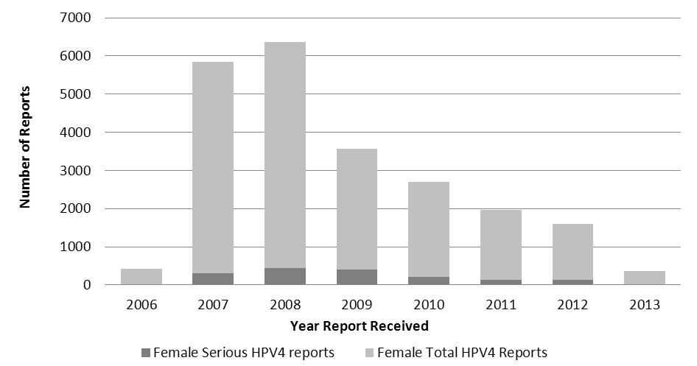
Trends in Total and Serious Female HPV4 Vaccine Reports to VAERS by Year, June 2006 – March 2013 (N=21,194)
MMWR 2013;62:591-595
33
Notes:
In the seven years of HPV vaccine safety studies and monitoring that have been conducted since the vaccine was licensed, no serious safety concerns have been identified. Reports to the Vaccine Adverse Event Reporting System (VAERS) have decreased each year since 2008.

Slide 34
HPV4 Rapid Cycle Analysis Results:
Vaccine Safety Datalink
VSD active surveillance of HPV4 among females confirmed no significant risk for any of the pre-specified adverse events after vaccination
  GBS, seizures, syncope, appendicitis, stroke, venous thromboembolism, and other allergic reactions
  Additional study is needed for a possible non-statistical association between HPV4 and venous thromboembolism
No increase in rate of anaphylaxis following HPV4 as compared to previous VSD studies
Extended follow-up for GBS and stroke among females 9-26 years of age found no increased risk
Markowitz L, ACIP presentation, June 2013
Gee J et al, Monitoring the safety of quadrivalent human papillomavirus vaccine: findings from the Vaccine Safety Datalink. Vaccine 2011;29:8279-8284.
Notes:
Through March 2013 more than 1.82M doses of quadrivalent HPV vaccine were administered in the VSD, with ~270K doses given to males.

Slide 35
Institute of Medicine Report
Adverse Effects of Vaccines: Evidence and Causality
IOM reviewed possible associations between adverse health events and eight vaccines
    Evidence “favors acceptance” of a causal relationship between HPV vaccine and anaphylaxis (yeast and latex components)
    Evidence “convincingly supports” a causal relationship between the injection of a vaccine and syncope
  Inadequate evidence was found for causal relationships between HPV vaccination and 12 other specific health events studied
Institute of Medicine. Adverse Effects of Vaccines: Evidence and Causality. Washington DC. The National Academies Press, 2012.
Notes:
NEED TALKING POINTS

Slide 36
Inadvertent Administration of HPV Vaccine during Pregnancy
No safety concerns* raised by HPV4 in pregnancy registry
CDC/FDA continue to monitor the safety of HPV vaccine, including reports in pregnant women through VAERS
A retrospective analysis of pregnancy-associated HPV4 VAERS reports is in progress (2005-2012)
  >85% of reports were submitted from the Merck Pregnancy Registry so anticipate a similar safety profile
For VSD, descriptive data of adverse events following inadvertent exposure to HPV4 during pregnancy by 2015
*death, life-threatening illness, hospitalization, prolongation of existing hospitalization, persistent or significant disability, congenital malformations
36
Notes:
NEED TALKING POINTS

Slide 37
HPV Vaccine Impact
Notes:
This next section will focus on the impact of HPV vaccine.

Slide 38
HPV Vaccine
Duration of Immunity
Studies suggest that vaccine protection is long-lasting; no evidence of waning immunity
  Available evidence indicates protection for at least 8-10 years
  Multiple cohort studies are in progress to monitor the duration of immunity
Romanowski B. Long term protection against cervical infection with the human papillomavirus: review of currently available vaccines. Hum Vaccin. 2011 Feb;7(2):161-9.
Notes:
A question we are asked often is, “how long will the protection provided by the HPV vaccine last?” Studies suggest that vaccine protection is long-lasting.
In 2010, a review of HPV vaccines was conducted regarding the long-term protection against cervical infection with the human papillomavirus. At that time the vaccines were shown to provide protection against persistent cervical HPV 16/18 infections for up to 8 years, which was the maximum time of research follow-up at that point. More will be known about the total duration of protection as research continues but at this time there is no evidence of waning immunity such has been seen with the meningococcal conjugate vaccine which now requires a second dose.
This information will be updated as additional data regarding duration of protection become available.
Romanowski B. Long term protection against cervical infection with the human papillomavirus: review of currently available vaccines. Hum Vaccin. 2011 Feb;7(2):161-9.

Slide 39
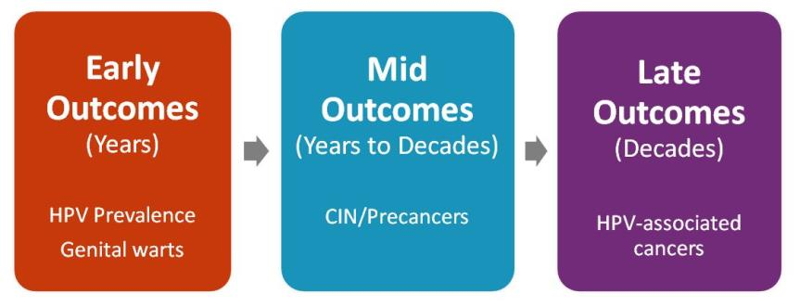
Monitoring Impact of HPV Vaccine Programs: HPV-associated Outcomes
Notes:
Post-licensure monitoring is important to evaluate the real-world impact of vaccination on populations, and a variety of activities are underway to assess HPV vaccine impact on early, mid-, and late outcomes. Reduction in vaccine type HPV provides early evidence of impact on infection, and reduction in anogenital warts is the first disease to be impacted by the quadrivalent HPV vaccine. Cervical lesions that are detected through routine screening can be used as mid outcomes, and late outcomes include all HPV-associated cancers.

Slide 40
HPV Vaccine Impact:
HPV Prevalence Studies
NHANES Study
  National Health and Nutrition Examination Survey (NHANES) data used to compare HPV prevalence before the start of the HPV vaccination program with prevalence from the first four years after vaccine introduction
  In 14-19 year olds, vaccine-type HPV prevalence decreased 56 percent, from 11.5 percent in 2003-2006 to 5.1 percent in 2007-2010
  Other age groups did not show a statistically significant difference over time
  The research showed that vaccine effectiveness for prevention of infection was an estimated 82 percent
Cummings T, Zimet GD, Brown D, et al. Reduction of HPV infections through vaccination among at-risk urban adolescents. Vaccine. 2012; 30:5496-5499.
Notes:
The CDC used data collected from the National Health and Nutrition Examination Survey (NHANES) to determine prevalence of HPV infection before and after HPV vaccine introduction. HPV prevalence declined by half after vaccine introduction in 14-19 year olds. This is the age group we’d expect to see an impact with. The study also showed that the vaccine is very effective which is what was seen during the prelicensure clinical trials.

Slide 41
Prevalence of HPV 6, 11,16, 18* in Cervicovaginal Swabs, by Age Group, NHANES, 2003-2006 and 2007-2010, U.S.
56% decline
*weighted prevalence
Markowitz, et al. Reduction in HPV prevalence among young women following HPV vaccine introduction in the United States, NHANES, 2003-2010. J Infect Dis 2103
41

Slide 42
HPV Vaccine Impact:
HPV Prevalence Studies, continued
Clinic-Based Studies
  Significant decrease from 24.0% to 5.3% in HPV vaccine type prevalence in at-risk sexually active females 14-17 years of age attending 3 urban primary care clinics from 1999-2005, compared to a similar group of women who attended the same 3 clinics in 2010
  Significant declines in vaccine type HPV prevalence in both vaccinated and unvaccinated women aged 13-26 years who attended primary care clinics from 2009-2010 compared to those from the pre-vaccine period (2006-2007)
Kahn JA, Brown DR, Ding L, et al. Vaccine-Type Human Papillomavirus and Evidence of Herd Protection After Vaccine Introduction. Pediatrics. 2012; 130:249-56.
Notes:
Similar declines in HPV prevalence have been demonstrated in smaller studies conducted in primary care clinics

Slide 43
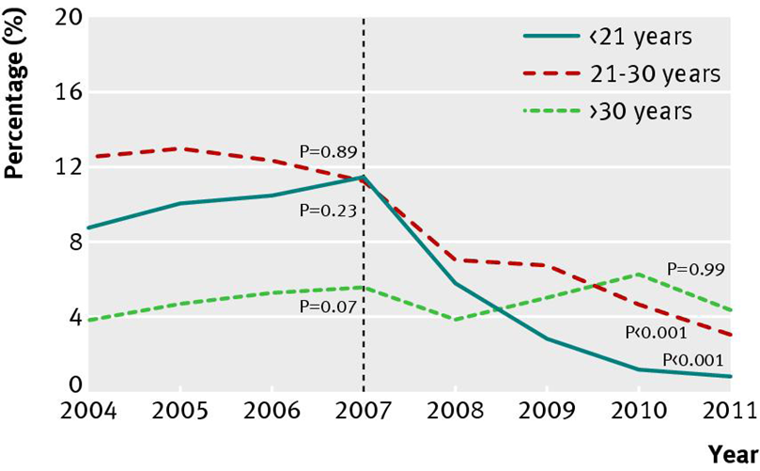
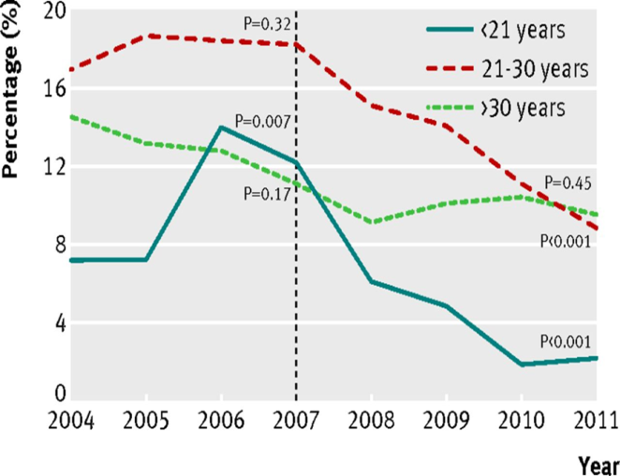
Impact of HPV vaccination in Australia
Proportion of Australian born females and males diagnosed as having genital warts at first visit, by age group, 2004-11
Females
Males
Ali, et al., Genital warts in young Australians five years into national human papillomavirus vaccination programme: national surveillance data. British Med J 2013;346:f2032
43
Notes:
Australia has high HPV vaccine coverage and has seen declines prevalence of HPV infections, pre-cancerous lesions, and genital warts in young women. HPV vaccine was only recommended for girls in Australia until 2012, yet they have seen a decline in genital warts in young men, which shows that there has been a decrease in transmission of HPV.

Slide 44
Impact of HPV Vaccine on HPV 16/18 Precancers
CIN2+ cases women 18 to 31 years of age were reported from pathology laboratories in 5 states from 2008 to 2011
  Of 5083 CIN2+ cases, 3855 had vaccination histories investigated, and 1900 had vaccine history documented
Among women with CIN2+ who had started HPV vaccine more than 24 months before their Pap smear, there was a significant reduction in HPV 16/18-related lesions
  These results suggest an early impact of the HPV vaccine on vaccine-type precancers
Powell S, et al, Impact of human papillomavirus (HPV) vaccination on HPV 16/18-related prevalence in precancerous cervical lesions. Vaccine 2012;31:109-113
44
Notes:
NEED TALKING POINTS

Slide 45
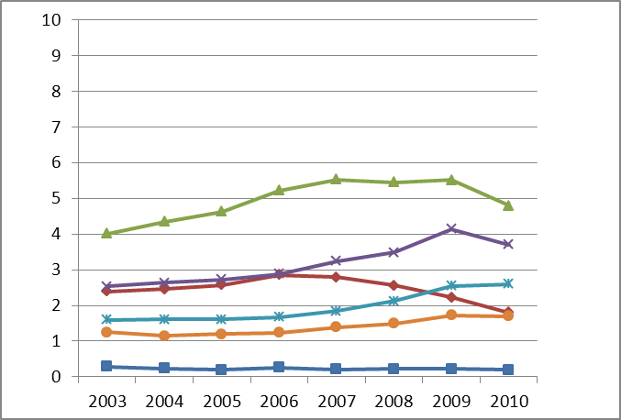
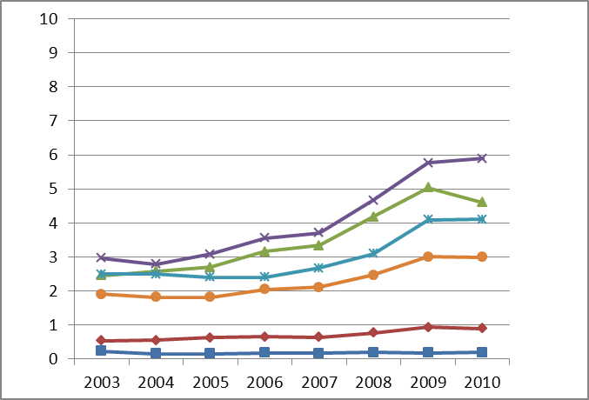
Anogenital Wart Prevalence per 1000 person-years,
US Private Insurance Enrollees, by Age, 2003-2010
Females
Males
Prevalence per 1000 Person-years
25-29
20-24
20-24
25-29
30-34
30-34
35-39
15-19
35-39
15-19
10-14
10-14
Flagg, et al. AJPH 2013

Slide 46
Impact of Bivalent HPV Vaccine on Oral HPV Infection
Of 7,466 women 18-25 years of age randomized to receive HPV vaccine or hepatitis A vaccine, 5,840 provided oral specimens at the final 4-year study visit
  Oral prevalence of identifiable mucosal HPV was relatively low (1.7%)
There were 15 HPV 16/18 infections in the hepatitis A comparison group and 1 in the HPV vaccine group, for an estimated vaccine efficacy of 93.3%
  These results suggest that the vaccine provides strong protection against oral HPV 16/18 infection and may prevent HPV 16/18-associated oropharyngeal cancers
Herrero R, et al. Reduced prevalence of oral human papillomavirus (HPV) 4 years after bivalent HPV vaccination in a randomized clinical trial in Costa Rica. PLOS ONE 2013;8:e68329
46

Slide 47
HPV Vaccine coverage
Notes:
This next section will focus on HPV vaccine coverage.

Slide 48
Strong Start?
Adolescent Immunization Coverage, US 13-17 year olds
National Immunization Survey-Teen (NIS-Teen) 2006 vs. 2007
CDC. National and State Vaccination Coverage Among Adolescents Aged 13–17 Years — United States, 2012
MMWR 2013; 62(34);685-693.

Slide 49
Adolescent Vaccination Coverage
United States, 2006-2013
MMWR 2014; 63(29);625-633.
Notes:
The strong coverage rates for Tdap vaccine demonstrate that not only are most preteens and teens getting to the doctor, but they are also getting at least one of the recommended adolescent vaccines.

Slide 50
Impact of Eliminating Missed Opportunities by Age 13 Years in Girls Born in 2000
Missed opportunity: Healthcare encounter when some, but not all ACIP-recommended vaccines are given. HPV-1: Receipt of at least one dose of HPV.
MMWR. 63(29);620-624.
Notes:
From 2012 to 2013, the percentage of adolescents receiving at least 1 dose of HPV vaccine increased 3.5 percentage points for girls. A cohort analysis also was performed to evaluate
receipt of at least 1 dose of HPV vaccine by age 13 years over time and found an increase since 2007; however, missed vaccination opportunities persist. Had HPV vaccine been administered
during health care visits when another vaccine was administered, vaccination coverage for at least one 1 dose could have reached 91.3% by age 13 years for adolescent girls born in 2000.
High HPV vaccination coverage with existing infrastructure and health-care utilization is possible in the United States. Taking advantage of every health-care encounter, including acute-care visits, to assess every adolescent’s vaccination status can help minimize missed opportunities. Potential strategies include using vaccination prompts available through electronic health records or checking local and state immunization information systems to assess vaccination needs at every encounter. Series completion also can be promoted through scheduling appointments for second and third doses before patients leave providers’ offices after receipt of their first HPV vaccine doses and with automated reminder-recall systems.

Slide 51
26 million: number of girls under 13 years of age in the United States
168,400: number who will develop cervical cancer if none are vaccinated
54,100: number will die from cervical cancer if none are vaccinated
For each year we stay at 30% coverage instead of achieving 80%
4,400: number of future cervical cancer cases we will not prevent
1,400: number of cervical cancer deaths we will not prevent
Adapted from Chesson HW et al, Vaccine 2011;29:8443-50

Slide 52
HPV Vaccine Series Initiation
Girls 13-17 Years, by State, 2013

Slide 53
Evidence-based strategies to improve vaccination coverage
Reminder/recall system
  Provider level (e.g., EMR prompts)
  Parent/patient level (e.g., postcards, telephone calls, text messaging)
Standing orders
Provider assessment and feedback
  Assessment of vaccination coverage levels within the practice and discussion of strategies to improve vaccine delivery
Utilizing immunization information systems
www.thecommunityguide.org/vaccines/universally/index.html

Slide 54
Impact of Reminder/Recall on Vaccination
Rates among Adolescents
*p<0.05
Percent
Vaccine
Suh C et al. Pediatrics 2012;129:e1437-45

Slide 55
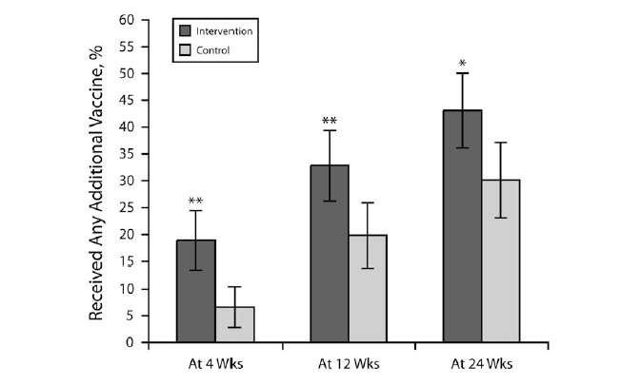
Percentages of adolescents 11-18 years of age who received any vaccination at 4, 12, and 24 weeks:
Text4Health-Adolescents, New York City, 2009
Stockwell et al. AJPH. 2012;102:e15-e21.

Slide 56
AFIX: Quality Improvement
Assessment
AFIX
Incentives
eXchange
Feedback
Notes:
AFIX is a quality improvement program used by awardees to raise immunization coverage levels, reduce missed opportunities to vaccinate, and improve standards of practices at the provider level. The acronym for this four-part dynamic strategy stands for
1.Assessment of the healthcare provider's vaccination coverage levels and immunization practices.
2.Feedback of results to the provider along with recommended quality improvement strategies to improve processes, immunization practices, and coverage levels.
3.Incentives to recognize and reward improved performance.
4.eXchange of information with providers to follow up on their progress towards quality improvement in immunization services and improvement in immunization coverage levels.

Slide 57
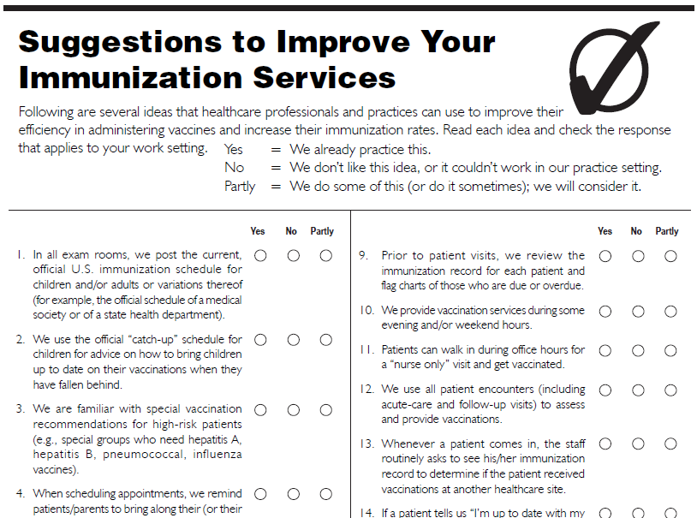
AFIX
cdc.gov/vaccines/programs/afix/index.html

Slide 58
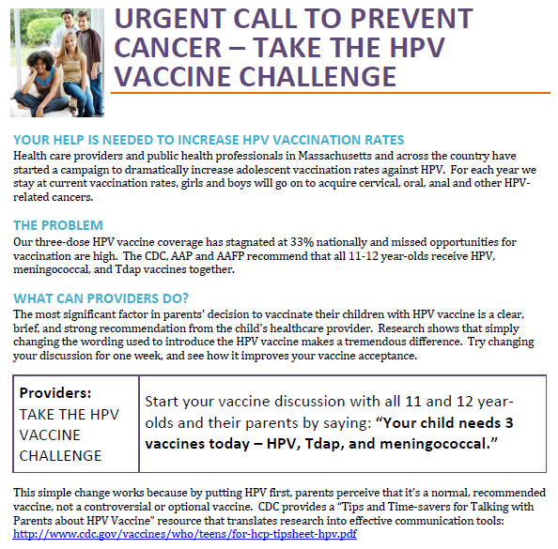

Slide 59
Framing the conversation
Talking about HPV vaccine
Notes:
This next section focuses on strategies to improve HPV vaccine recommendations and conversations with patients and their parents

Slide 60
Evidence-Based Messages
Parents should:
  Realize HPV vaccine is CANCER PREVENTION
  Understand HPV vaccine is best at 11 or 12 years old
  Recognize importance of getting all 3 shots
Healthcare Professionals should:
  Be familiar with all of the indications for HPV vaccine
  Make strong recommendations for receiving vaccine at 11 or 12
  Be aware of, and interested in, systems that can improve practice vaccination rates
Notes:
NEED TALKING POINTS FOR THIS SLIDES

Slide 61
HPV Vaccine Communications During the Healthcare Encounter
HPV vaccine is often presented as ‘optional’ whereas other adolescent vaccines are recommended
Some expressed mixed or negative opinions about the ‘new vaccine’ and concerns over safety/efficacy
When parents expressed reluctance, providers were hesitant to engage in discussion
Some providers shared parents’ views that teen was not at risk for HPV and could delay vaccination until older
Goff S et al. Vaccine 2011;10:7343-9
Hughes C et al. BMC Pediatrics 2011;11:74
Goff S et al. Vaccine 2011;10:7343-9
Hughes C et al. BMC Pediatrics 2011;11:74
Notes:
Communication of HPV vaccine during the healthcare encounter is also very important to vaccine acceptance. Several qualitative evaluations have been done regarding this issue. Common themes found from these studies show that the vaccine isoften presented as optional whereas other vaccines indicated for adolescents were recommended. Also, some providers expressed mixed or negative opinions about the vaccine. When parents expressed reluctance to the vaccine, providers were hesitant to engage in discussion. Finally some providers shared the parent’s the view that it was acceptable to delay vaccination until the teen was older.

Slide 62
Top 5 reasons for not vaccinating daughter, among parents with no intention to vaccinate in the next 12 months, NIS-Teen 2012
13%
CDC. National and State Vaccination Coverage Among Adolescents Aged 13–17 Years — United States, 2012
MMWR 2014; 63(29);625-633.
Notes:
This slide shows the responses that parents gave when asked why they would not be getting the HPV vaccine for their daughter in the next year.
Three reasons that parents provided—lack of knowledge, not needed, and not sexually active—all demonstrate a lack of understanding on the part of the parent, especially why it is important to vaccinate at ages 11 or 12. Parents need to be told that HPV vaccine is cancer prevention and that it must be given prior to exposure.
Safety concerns can be allievated by sharing the tremendous amount of data before and after the vaccine was licensed that demonstrate that HPV vaccine is safe.

Slide 63
Is she really too young? Take 1
(a conversation you may be familiar with)
Provider: Meghan is due for some shots today: Tdap and the meningococcal vaccine. There is also the HPV vaccine…
Parent: Why does she need an HPV vaccine? She’s only 11!
Provider: We want to make sure she gets the shots before she becomes sexually active.
Parent: Well I can assure you Meghan is not like other girls- she’s a long way off from that!
Provider: We can certainly wait if that would make you feel more comfortable.
Notes:
Now we will discuss reframing the conversation about HPV vaccine.
This is the first of three vaccine recommendation scenarios that we will review. What concerns you about this scenario? How else could this have been handled?

Slide 64
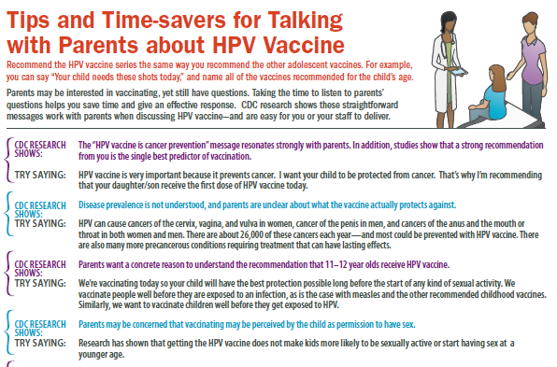
Framing the HPV Vaccine Conversation
Notes:
One-sided “at a glance” style factsheet
Also available as web content
Developed from message testing with moms and audience research with doctors and clinicians
Each “statement” is coupled with finding from formative research
The next several slides will cover the information in this tip sheet in depth.

Slide 65
What’s in a recommendation?
  Studies consistently show that a strong recommendation from you is the single best predictor of vaccination
    In focus groups and surveys with moms, having a doctor recommend or not recommend the vaccine was an important factor in parents’ decision to vaccinate their child with the HPV vaccine
    Not receiving a recommendation for HPV vaccine was listed a barrier by mothers
Unpublished CDC data, 2013.

Slide 66
Just another adolescent vaccine
Successful recommendations group all of the adolescent vaccines
  Recommend the HPV vaccine series the same way you recommend the other adolescent vaccines
  Moms in focus groups who had not received a doctor’s recommendation stated that they questioned why they had not been told or if the vaccine was truly necessary
  Many parents responded that they trusted their child’s doctor and would get the vaccine for their child as long as they received a recommendation from the doctor
Unpublished CDC data, 2013.

Slide 67
Providers underestimate the value parents place on HPV vaccine
Adapted from Healy et al. Vaccine. 2014;32:579-584.

Slide 68
Try saying:
Your child needs three shots today: HPV vaccine, meningococcal vaccine and Tdap vaccine.
You child will get three shots today that will protect him/her from many cancers caused by HPV, as well as to prevent tetanus, diphtheria, pertussis and meningitis.

Slide 69
A case of vaccine hesitancy?
Parents may be interested in vaccinating, yet still have questions
  However, many parents didn’t have questions or concerns about HPV vaccine
  A question from a parents does not mean they are refusing or delaying
  Taking the time to listen to parents’ questions helps you save time and give an effective response
  CDC research shows these straightforward messages work with parents when discussing HPV vaccine—and are easy for you or your staff to deliver
Unpublished CDC data, 2013.

Slide 70
An anti-cancer vaccine
The “HPV vaccine is cancer prevention” message resonates strongly with parents
  In focus groups and online panels, mothers wanted more information on the types of HPV cancers
  In focus groups mothers stated they were influenced to vaccinate their child because HPV vaccine prevents cancer, they had a family history of cervical cancers, and/or because they had a personal experience with cervical cancer
Unpublished CDC data, 2013.

Slide 71
Try saying:
HPV vaccine is very important because it prevents cancer.
I want your child to be protected from cancer.
That’s why I’m recommending that your daughter/son receive the first dose of the HPV vaccine series today.

Slide 72
Tell me doctor, how bad is it?
Parents don’t know that HPV is very common
Disease prevalence is not understood
Parents are unclear about what the vaccine actually protects against
Unpublished CDC data, 2013.

Slide 73
Try saying:
Persistent HPV infection can cause cancers of the cervix, vagina, and vulva in women, cancer of the penis in men, and cancers of the anus and the mouth or throat in both women and men.
There are about 26,000 of these cancers each year—and most could be prevented with HPV vaccine.
There are also many more precancerous conditions requiring treatment that can have lasting effects.

Slide 74
HPV Transmission
Almost everyone will be infected but most people will never know
47% of high school students have already engaged in sexual (vaginal-penile) intercourse
  6% of students had sexual intercourse before age 13
  1/3 of 9th graders and 2/3 of 12th graders have engaged in sexual intercourse
  1 in 7 high school students (all grades) have had sexual intercourse with 4 or more partners
Jemal A et al. J Natl Cancer Inst 2013;105:175-201
Kahn. MMWR. 2014; 63(4)
Notes:
HPV is transmitted through skin-to-skin contact through vaginal, anal, or oral intercourse. Condoms do not completely stop transmission of HPV.
This data demonstrates how young someone can be exposed to HPV

Slide 75
Try saying:
HPV is so common that almost everyone will be infected at some point. It is estimated that 79 million Americans are currently infected with 14 million new HPV infections each year.
Most people infected will never know. Even if your child waits until marriage to have sex, or only has one partner in the future, he/she could still be exposed, if their partner has already been exposed.

Slide 76
Why at 11 or 12 years old?
Parents want a concrete reason why 11-12 year olds should receive HPV vaccine
  In audience research with moms, almost all respondents were unaware of the correct age range the vaccine was recommended
  Respondents also missed the concept of vaccinating before sexual activity
Unpublished CDC data, 2013.

Slide 77
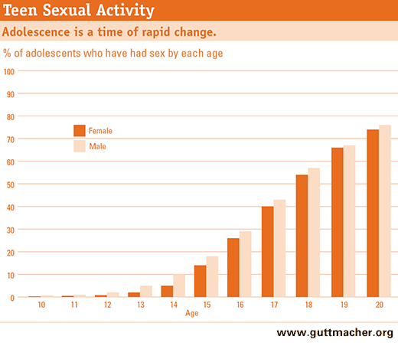
Rationale for vaccinating early:
Protection prior to exposure to HPV
Notes:
HPV vaccines should be given prior to exposure to HPV. There is no reason to wait until a teen is having sex. We don’t wait until exposure occurs to give any other routinely recommended vaccine- we give the vaccine before we think exposure is likely to occur to ensure the best protection.

Slide 78
Try saying:
We're vaccinating today so your child will have the best protection possible long before the start of any kind of sexual activity.
We vaccinate people well before they are exposed to an infection, as is the case with measles and the other routinely recommended childhood vaccines. Similarly, we want to vaccinate children long before they begin any type of sexual activity and are exposed to HPV.
Also HPV vaccine produces a better immune response in preteens than it does in older teens and young women.
Notes:
Immunogenicity Bridge to Efficacy Among Females: Immunogenicity studies provide data, allowing comparison of seropositivity and GMTs among females aged 9--15 years with those among females aged 16--26 years who were in the efficacy studies (Table 6) (111). Seropositivity rates in all age groups were approximately 99% for HPV 6, 11, 16, and 18. Anti-HPV responses 1 month post dose 3 among females aged 9--15 years were noninferior to those aged 16--26 years. At month 18, anti-HPV GMTs in females aged 9--15 years remained two to three fold higher than those observed at the same time point in females aged 16--26 years in the vaccine efficacy trials.
REFERENCE: Quadrivalent Human Papillomavirus Vaccine: Recommendations of the Advisory Committee on Immunization Practices (ACIP). MMWR. 2007; 56(RR02);1-24.

Slide 79
A green light for sexual activity?
Parents may be concerned that vaccinating may be perceived by the child as permission to have sex
  In focus groups, some parents expressed concern that in getting HPV vaccine for their child, they would be giving their child permission to have sex
  This was one of the top four reasons respondednts gave when asked why they would not vaccinate their daughter
  A few parents expressed that while they wanted their child to “wait to have sex” they understood that might not be the case
Unpublished CDC data, 2013.

Slide 80
Receipt of HPV vaccine does not increase sexual activity or decrease age of sexual debut
Kaiser Permanente Center for Health Research
1,398 girls who were 11 or 12 in 2006, 30% of whom were vaccinated, followed through 2010
No difference in markers of sexual activity, including
  Pregnancies
  Counseling on contraceptives
  Testing for, or diagnoses of, sexually transmitted infections
Bednarczyk Pediatrics Oct 2012
Notes:
Parents may be concerned that letting their child receive HPV vaccine will be seen by the child as permission to have sex. However, multiple studies have demonstrated that girls who receive HPV vaccine do not engage in sexual intercourse sooner than their peers who did not receive HPV vaccine.

Slide 81
Try saying:
Multiple research studies have shown that getting the HPV vaccine does not make kids more likely to be sexually active.
These studies have also shown that getting the HPV vaccine does not make kids more likely to start having sex a younger age.

Slide 82
But she’s too young!
Parents might believe their child won't be exposed to HPV because they aren't sexually active or may not be for a long time
  In focus groups, some moms couldn’t understand how their child could become infected even if they waited until marriage to have sex
  Some moms stated that they didn’t think HPV infection was very common because they had never heard that it was or didn’t know anyone who had an HPV infection or HPV disease
Unpublished CDC data, 2013.

Slide 83
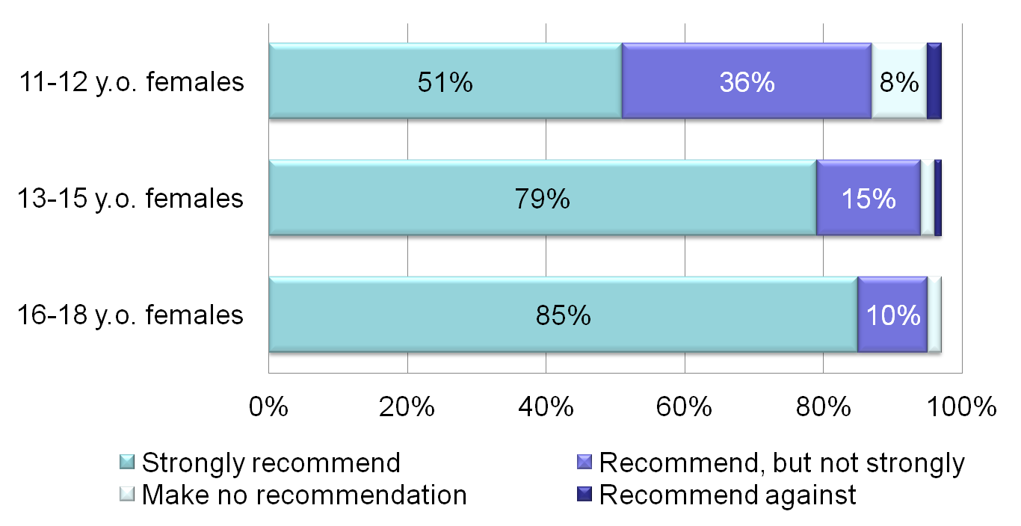
Strength of HPV Vaccine Recommendation for Female Patients, Pediatricians and
Family Physicians (N=609)
Allison et al. https://cdc.confex.com/cdc/nic2011/webprogram/Paper25181.html
Notes:
When we have studied HPV vaccination practices among physicians we see that providers are less likely to recommend the HPV vaccine to their younger adolescent patients. This slide shows results of a national survey of pediatricians and family physicians. Only 51% of providers strongly recommend HPV for their female patients 11 to 12 years old as shown by the top light blue bar. And the percent who strongly recommend the vaccine increases with patient age.

Slide 84
Try saying:
We don’t wait until exposure occurs to give any other routinely recommended vaccine. HPV vaccine is also given when kids are 11 or 12 years old because it produces a better immune response at that age. That’s why it is so important to start the shots now and finish them in the next 6 months.

Slide 85
Would you give it to your child?
Emphasizing your personal belief in the importance of HPV vaccine helps parents feel secure in their decision
  Some respondents in focus groups stated that they would feel more comfortable knowing that the doctor had vaccinated their own child or was planning to (if the child was <11)
  Respondents in an online survey stated that knowing that oncologists supported the recommendation made them more likely to get their child vaccinated
Unpublished CDC data, 2012,2013.

Slide 86
Try saying:
I strongly believe in the importance of this cancer-preventing vaccine.
I have given HPV vaccine to my son/daughter (or grandchild/niece/nephew/friend's children).
Experts, such as the American Academy of Pediatrics, cancer doctors, and the CDC, also agree that getting the HPV vaccine is very important for your child.

Slide 87
Scared of side effects
Understanding that the side effects are minor and emphasizing the extensive research that vaccines must undergo can help parents feel reassured
  Moms in focus groups stated concerns about both short term and long term vaccine safety as a reason that they would not vaccinate their child
  Respondents were not aware that HPV vaccine was tested in adolescents and adults and were concerned that their child’s fertility could be affected by the vaccine
Unpublished CDC data, 2013.

Slide 88
Try saying:
HPV vaccine has been very carefully studied by scientific experts and it’s safety is continually monitored.
This is not a new vaccine and for years HPV vaccine has been shown to be very effective and very safe. HPV vaccine has a similar safety profile to the meningococcal and Tdap vaccines.
Like other shots, side effects can happen, but most are mild, primarily pain or redness in the arm. This should go away quickly, and HPV vaccine has not been associated with any long-term side effects.

Slide 89
Try saying:
Since 2006, about 62 million doses of HPV vaccine have been distributed in the U.S., and in the years of HPV vaccine safety studies and monitoring, no serious safety concerns have been identified.
There is no data to suggest that getting HPV vaccine will have an effect on future fertility. However, persistent HPV infection can cause cervical cancer and the treatment of cervical cancer can leave women unable to have children.
Even treatment for cervical pre-cancer can put a woman at risk for problems with her cervix during pregnancy which could cause preterm delivery or problems.

Slide 90
When do we come back?
Many parents do not know that the full vaccine series requires 3 shots
Your reminder will help them to complete the series
  In focus groups, most respondents did not know the dosing schedule for HPV vaccine
Unpublished CDC data, 2013.

Slide 91
Try saying:
I want to make sure that your son/daughter receives all 3 shots of HPV vaccine to give them the best possible protection from cancer caused by HPV infection.
Please make sure to make appointments for the second and third shots on the way out, and put those appointments on your calendar before you leave the office today!

Slide 92
Addressing all concerns in 45 seconds
Provider: Meghan is due for some shots today: HPV, meningococcal vaccine, and Tdap.
Parent: Why does she need an HPV vaccine? She’s only 11!
Provider: The HPV vaccine will help protect Meghan from cancer caused by HPV infection. We know that HPV infection is dangerous– 33,000 people in the US get cancer from HPV every year. And we know that the HPV vaccine is safe– over 100 million doses have been given and there haven’t been any serious side effects.
Parent: But it just seems so young…
Provider: Vaccines only work if they’re given before exposure– we never wait until a child is at risk to give any recommended vaccines. HPV vaccine is also given when kids are 11 or 12 years old because it produces a better immune response at that age. That’s why it is so important to start the shots now and finish all 3 of them in the next 6 months.
Notes:
Based on the previous slides, the scenario has been rewritten to reflect the clinicians new knowledge. How does this feel to you? Would you do anything differently?

Slide 93
Parents weigh risks and benefits
Parents who declined vaccine and those who accepted had similar concerns
Both had concerns related to safety and sexuality but accepters weighed cancer prevention more heavily
Most parents also believed their daughters would at some point be at risk for STIs
Providers overestimated parents concerns
Perkins et al, Clin Peds 2013
Perkins et al J of Peds 2010
Perkins et al J Healthcare Poor Underserved 2013
Notes:
Many clinicians perceive questions as parents as vaccine hesitancy. But is this parents really hesitant? How could the parent’s questions been answered?

Slide 94
HPV Vaccine is Cancer Prevention
HPV vaccine is safe, effective, and lasting protection against most cancers caused by HPV infection
HPV vaccination is best when given at 11 or 12 years of age
HPV vaccination rates have plateaued, leaving another generation at risk for HPV cancers

Slide 95
HPV Vaccine Messages
Clear, Concise, and Consistent Communication

Slide 96
1. HPV Vaccine Is Safe, Effective, and Provides Lasting Protection
HPV Vaccine is SAFE
  No serious sides effects
  HPV vaccine safety similar to MCV4 and Tdap vaccine safety
HPV Vaccine WORKS
  High grade cervical lesions decline in Australia
  Prevalence of vaccine types declined by 56% in U.S.
HPV Vaccine LASTS
  No evidence of waning immunity
Garland et al, Prev Med 2011; Ali et al, BMJ 2013; Markowitz JID 2013; Nsouli-Maktabi MSMR 2013
Notes:
The most common adverse events reported are considered mild
For serious adverse events reported, no unusual pattern or clustering that suggest events were caused by the HPV vaccine
These findings are similar to the safety reviews of MCV4 and Tdap vaccines
62 million doses of HPV vaccine distributed in US since 2006 through December 2013
Australia (80% of school-aged girls vaccinated)
High-grade cervical lesions have declined in women less than 18 years of age
For 15-24 year old females, the proportion of genital warts cases declined by 85%
Genital warts have declined by 71% among males of the same age, indicating herd immunity
United States (33% of teens fully vaccinated)
56% decline in HPV 6/11/16/18 in girls age 14-19
Substantial decrease in genital warts among female military under age 26 between 2007 to 2010
Studies suggest that vaccine protection is long-lasting; no evidence of waning immunity
Available evidence indicates protection for at least 8-10 years
Multiple cohort studies are in progress to monitor the duration of immunity

Slide 97
2. HPV Vaccination is best at 11 or 12
HPV vaccine works best when the entire series has been given before exposure to HPV
  Very little exposure to HPV at 11 and 12 years of age
  1/3 of 9th graders and 2/3 of 12th graders have engaged in sexual intercourse
  24% of high school seniors have had sexual intercourse with four or more partners
Higher immune response from HPV vaccine in preteens than in older teens

Slide 98
3. HPV Vaccination Rates have Plateaued
Stagnant HPV vaccination rates are leaving another generation vulnerable to devastating HPV cancers
  Most of these cancers could be prevented with vaccination
HPV vaccination rates are lagging behind the rates of the other vaccines for preteens and teens
  In 2012, 8 in 10 girls who had not yet started the HPV vaccine series saw a healthcare provider and received at least one vaccine, but not HPV vaccine; if these girls all received HPV vaccine, first dose coverage could be be 93%
High HPV vaccination coverage is possible with the current healthcare structure

Slide 99
High-Impact Statements
HPV cancers are devastating to men and women
  This is especially true for the cancers that are not routinely screened (cancers of the anus, mouth/throat, penis, vagina, and vulva); these cancers are difficult to treat and can result in tremendous pain, disfigurement, and even death
We finally have a vaccine for cancer
  Yet only one third of girls have finished the HPV vaccine series
How often do we really get the chance to prevent cancer?
  HPV vaccine is cancer prevention.

Slide 100
Review
Give a STRONG recommendation
  Ask yourself, how often do you get a chance to prevent cancer?
Start conversation early and focus on cancer prevention
  Vaccination given well before sexual experimentation begins
  Better antibody response in preteens
Offer a personal story
  Own children/Grandchildren/Close friends’ children
  HPV-related cancer case
Welcome questions from parents, especially about safety
  Remind parents that the HPV vaccine is safe and not associated with increased sexual activity
Notes:
Recommend the HPV vaccine series the exact same way you recommend the other adolescent vaccines.
Discuss HPV vaccine in the context of cancer prevention instead of sex
Let patients know that you support HPV vaccinaton personally
Answer questions confidently and give just the answer to the question they are asking- don’t give more information than the parents have asked for.

Slide 101
Review Question #1
HPV vaccine is recommended for the following persons:
All adolescents at the 11 to 12 year old visit.
Females only at the 13 year old visit.
Males only at the 11 to 12 year old visit.
Females only at the 11 to 12 year old visit.

Slide 102
Review Question #1
HPV vaccine is recommended for the following persons:
All adolescents at the 11 to 12 year old visit.
Females only at the 13 year old visit.
Males only at the 11 to 12 year old visit.
Females only at the 11 to 12 year old visit.

Slide 103
Review Question #2
Why should males receive quadrivalent HPV vaccine?
Prevention of infection with HPV types 6, 11, 16, 18.
Prevention of genital warts caused by HPV types 6 and 11.
Prevention of anal cancer caused by HPV types 16 and 18.
All of the above.

Slide 104
Review Question #2
Why should males receive quadrivalent HPV vaccine?
Prevention of infection with HPV types 6, 11, 16, 18.
Prevention of genital warts caused by HPV types 6 and 11.
Prevention of anal cancer caused by HPV types 16 and 18.
All of the above.

Slide 105
Review Question #3
Which of the following HPV vaccine recommendations for a child aged 11 or 12 years is the most likely to be successful?
Ask parent if child is sexually active and then discuss importance of HPV vaccination.
Tell parent that their child needs three vaccinations: HPV, MCV4, and Tdap.
Tell parent about the vaccinations that are mandatory for school entry and ask if they also want HPV vaccine.
Ask parent if they want to get HPV vaccination for their child or wait until the child is older.

Slide 106
Review Question #3
Which of the following HPV vaccine recommendations for a child aged 11 or 12 years is the most likely to be successful?
Ask parent if child is sexually active and then discuss importance of HPV vaccination.
Tell parent that their child needs three vaccinations: HPV, MCV4, and Tdap.
Tell parent about the vaccinations that are mandatory for school entry and ask if they also want HPV vaccine.
Ask parent if they want to get HPV vaccination for their child or wait until the child is older.

Slide 107
Communication Tools
Resources for HPV vaccine conversations

Slide 108
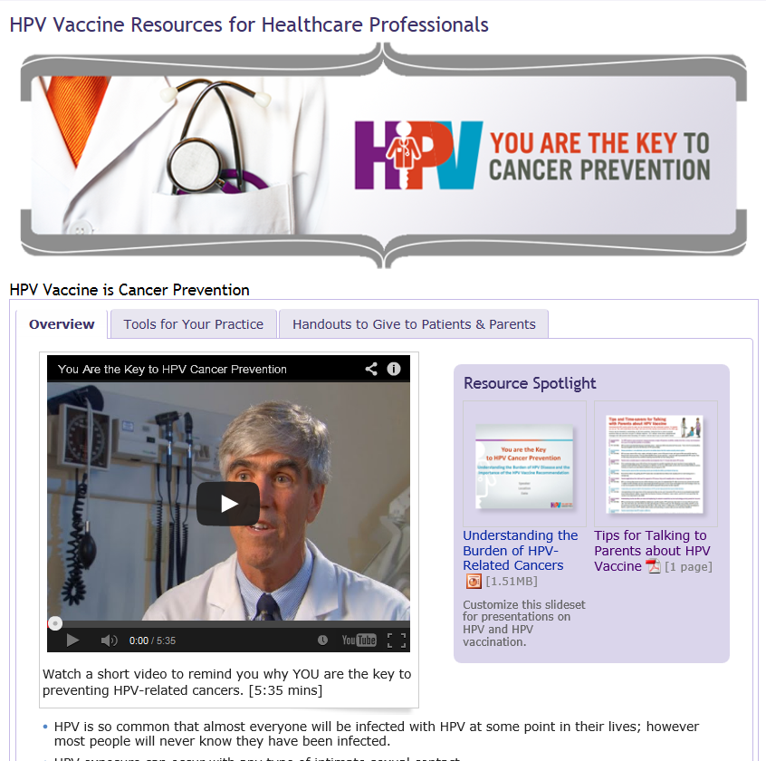
cdc.gov/vaccines/YouAreTheKey
Notes:
CDC launched a new website for healthcare professionals so everything about HPV vaccination is easily found in one place. The website is easy to navigate; it only has one page and three tabs. The first tab is the one you see here- the overview. I encourage you to watch the 5 minute video that was designed for healthcare professionals.

Slide 109
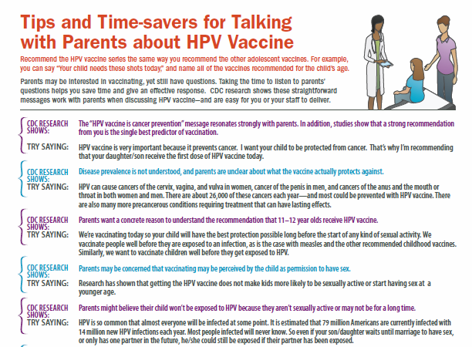
Tips for Talking to Parents about HPV Vaccine
Tools for your Practice
cdc.gov/vaccines/hpv-tipsheet
Notes:
This tip sheet, which is currently in the spotlight section on the overview tab, can also be found within the Tools for Your Practice tab. This tab also includes links to CDC Expert Commentaries on Medscape, free CME courses, the pink book, and other tools and information specifically designed for healthcare professionals.

Slide 110
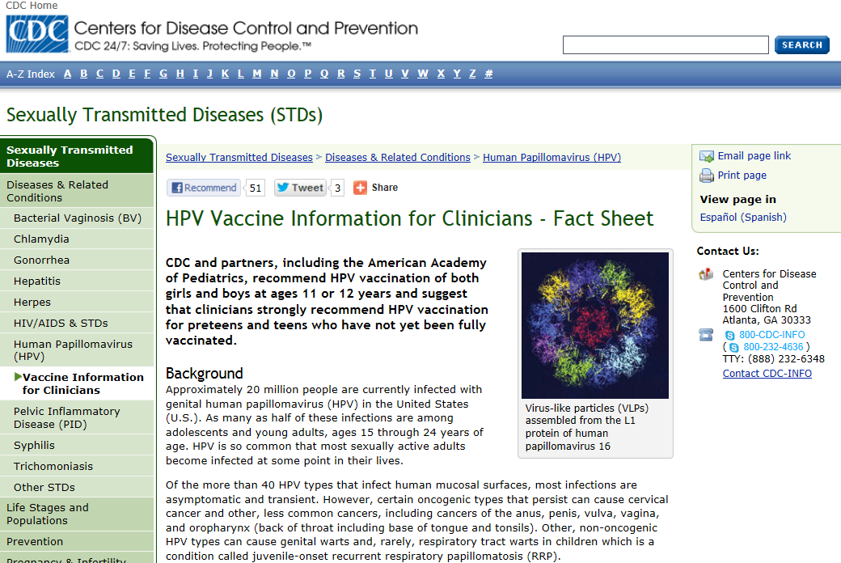
HPV Fact Sheet for Clinicians
Tools for your Practice
cdc.gov/std/hpv/STDFact-HPV-vaccine-hcp.htm
Notes:
This factsheet on HPV vaccine for clinicians is another example of a Tool for Your Practice.

Slide 111
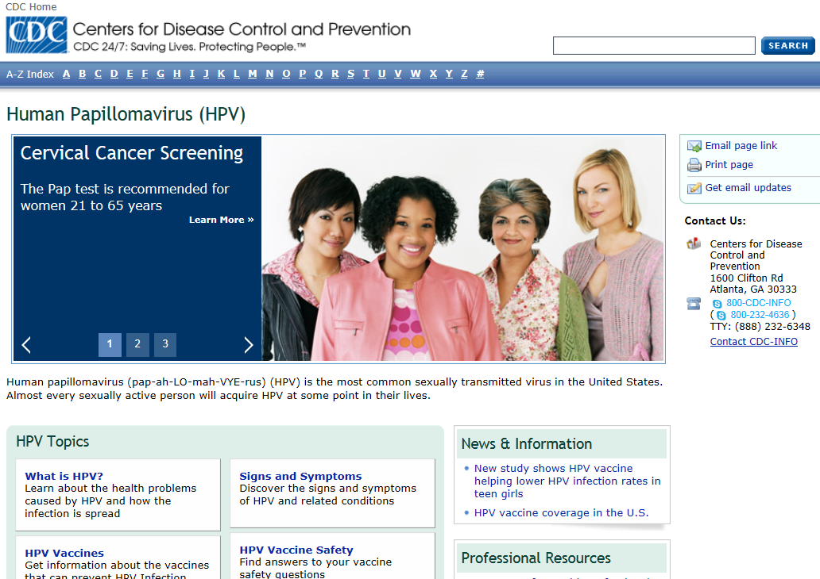
HPV Portal
Tools for your Practice
cdc.gov/hpv
Notes:
This is another tool- CDC’s HPV portal which has information for both clincians and the general public.

Slide 112
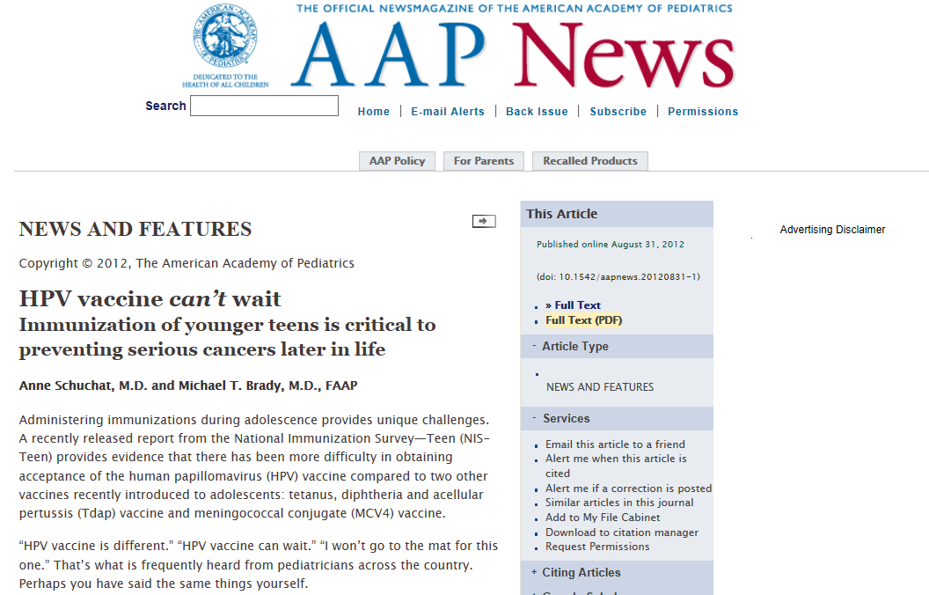
AAP—HPV Vaccine Can't Wait
Tools for your Practice
aapnews.aappublications.org/content/early/2012/08/31/aapnews.20120831-1.full.pdf
Notes:
Another tool to share with your practice is an article from AAP News about the importance of HPV vaccination.

Slide 113
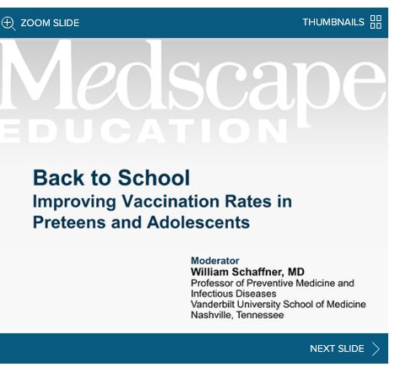
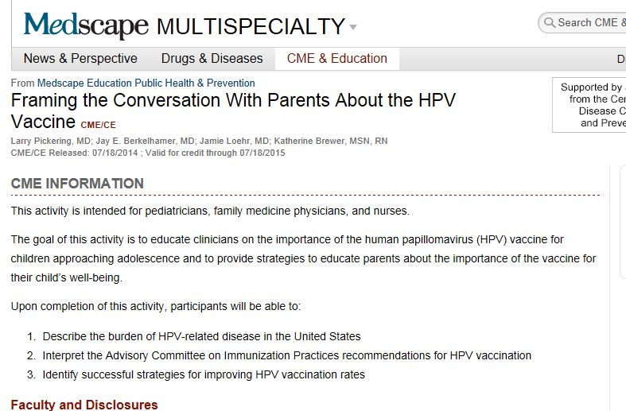
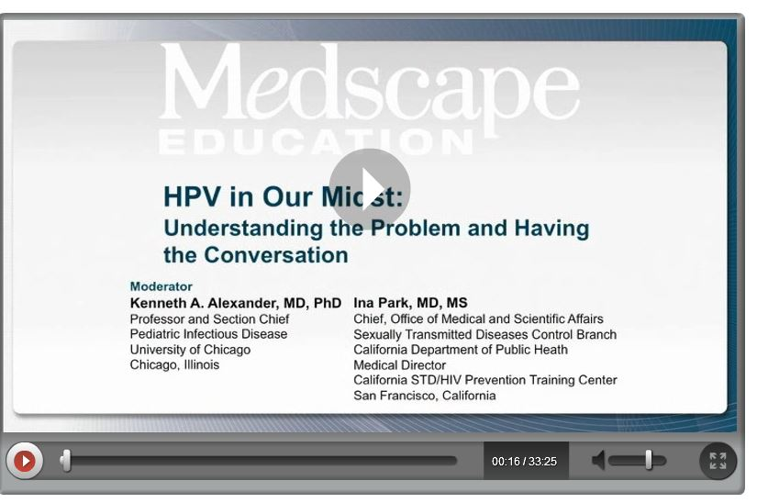
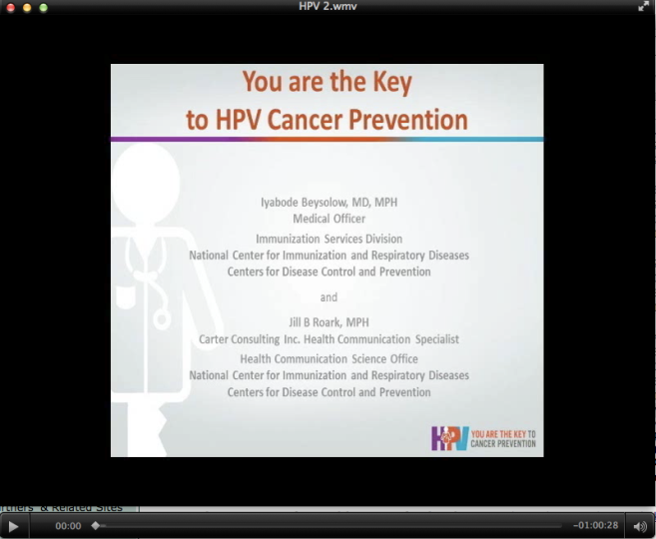
Continuing Education
Tools for your Practice
Notes:
Lastly, I’d like to touch on Continuing Education opportunities through this healthcare professional site. We have adolescent and HPV focused CMEs available Medscape at no cost. The links can be found on the Tools for Your Practice tab as well as the bottom of the Preteen and Teen Vaccines health care provider page.
All of these CMEs were recently updated this month including our latest CME, “Framing the Conversation with Parents About the HPV vaccine. This CME focuses on the conversation between parents and clinicians and discusses the best way to make the recommendation.
This CME was co-authored by nurses and physicians who are members AAP, AAFP and ANA. The CMEs also run between 30 minutes to one hour and are easy to follow.

Slide 114
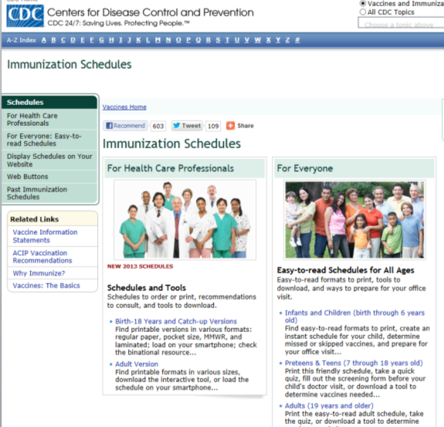
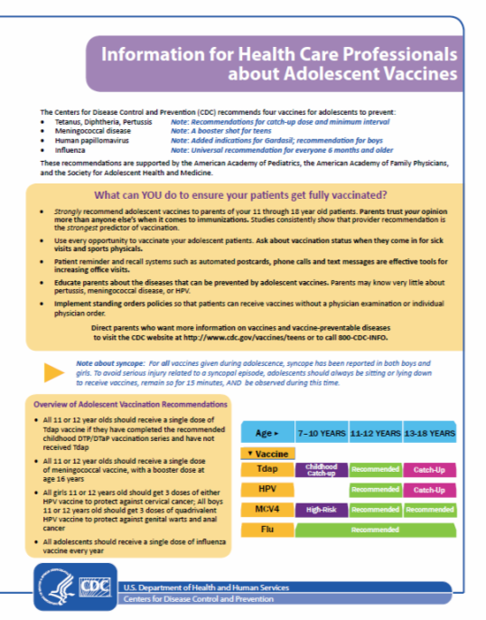
Immunization Schedules, Recommendations, and more
Tools for your Practice
cdc.gov/vaccines/who/teens/for-hcp/hpv-resources.html

Slide 115
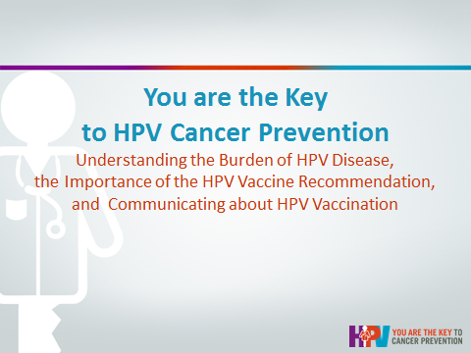
Customizable HPV Presentation
Tools for your Practice
To request a presentation, please email: preteenvaccines@cdc.gov
Notes:
We also have a presentation that provides an overview of the burden of HPV, the importance of the recommendation and how to communicate to your patients about the vaccine.
This presentation is something you can share with employees at your practice and your colleagues. This presentation is customizable, so you can pick and choose what slides are needed the most for your presentation.
To request this presentation, please send an email to preteenvaccines@cdc.gov or click on the link in the resource box on the first tab.

Slide 116
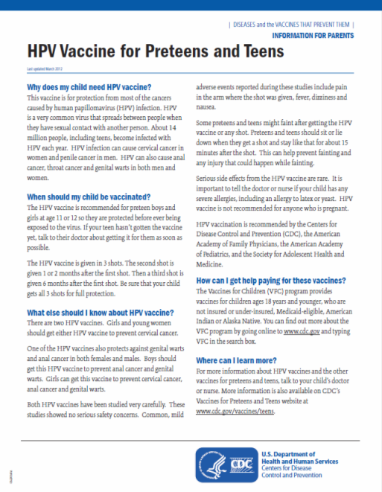
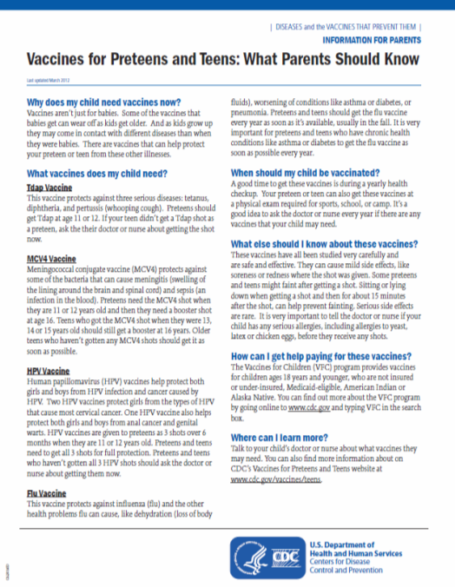
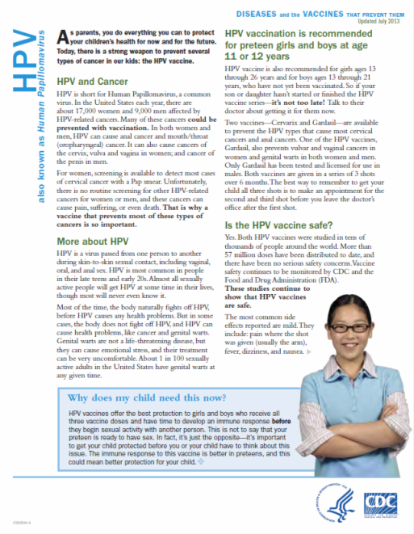
Patient and Parent Handouts
Resources for Patients
cdc.gov/vaccines/who/teens/products/print-materials.html
Notes:
There are three types of factsheets on the site:
An overview of all of the adolescent vaccines
A basic factsheet about HPV vaccine
An in-depth factsheet about HPV vaccine which includes a personal story from a cervical cancer survivor

Slide 117
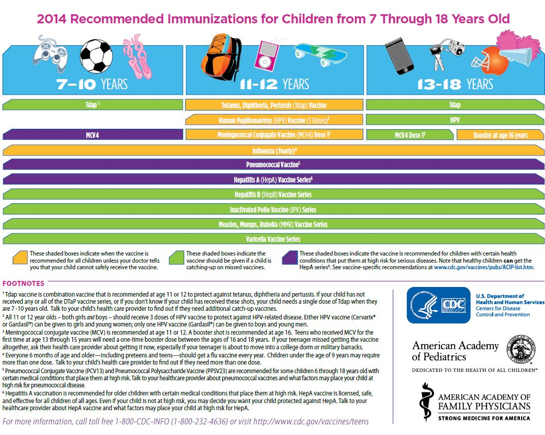
Adolescent Immunization Schedule
Resources for Patients
cdc.gov/vaccines/schedules/easy-to-read/preteen-teen.html
Notes:
The parent version or “easy to read” version of the adolescent immunization schedule

Slide 118
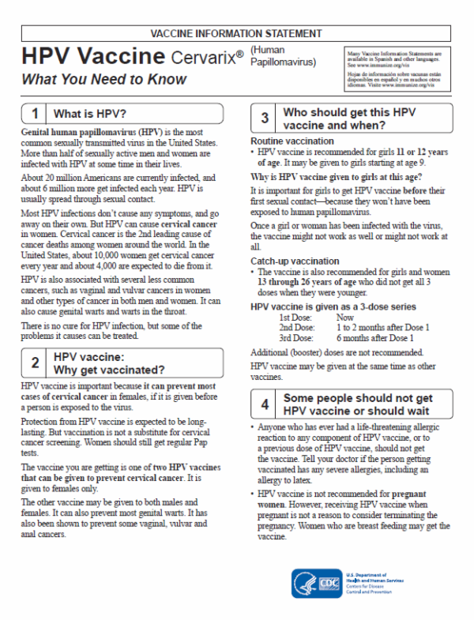
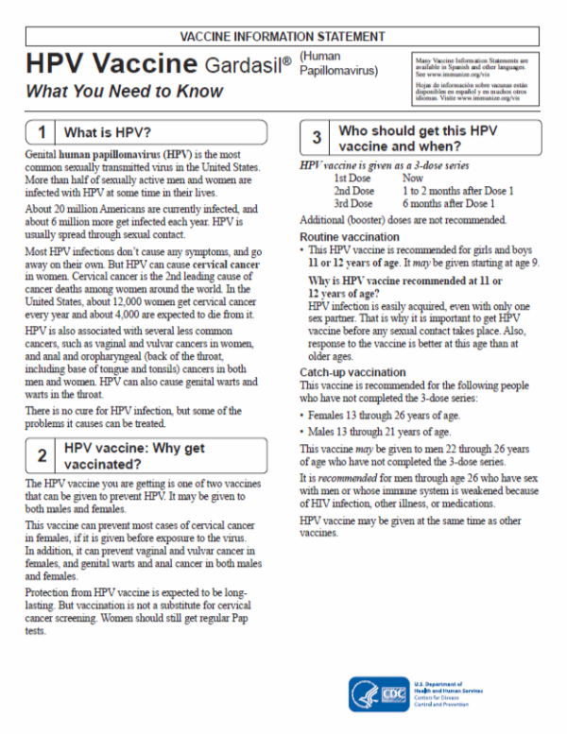
HPV Vaccine Information Sheets
Resources for Patients
cdc.gov/vaccines/hcp/vis/

Slide 119
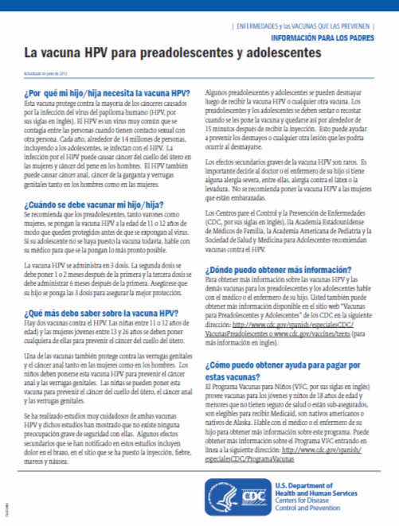
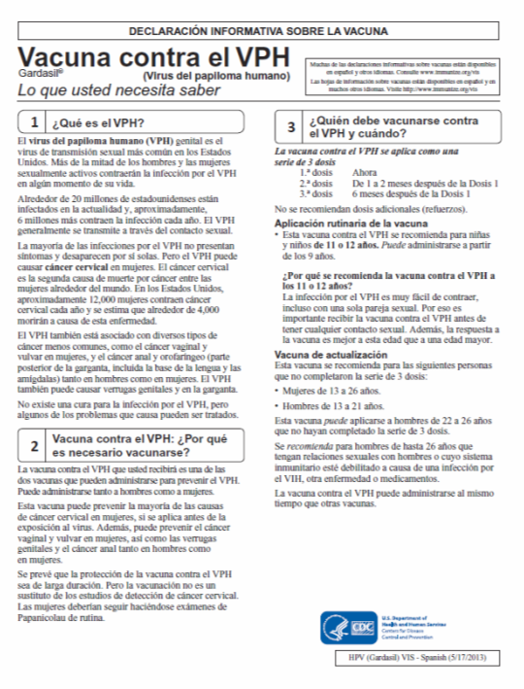
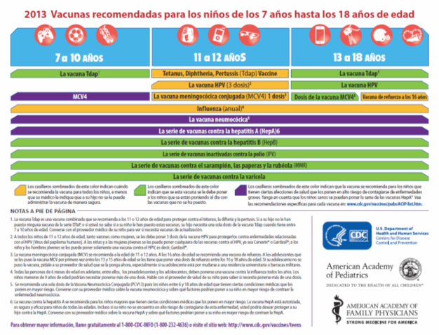
HPV Vaccine Resources in Spanish
Resources for Patients
cdc.gov/spanish/inmunizacion/index.html

Slide 120
For more information,
including free resources for yourself and your patients/clients, visit:
cdc.gov/vaccines/YouAreTheKey
Email questions or comments to
CDC Vaccines for Preteens and Teens:
PreteenVaccines@cdc.gov

Slide 121
HPV VACCINE IS CANCER PREVENTION
And YOU are the key!

